Slide 1
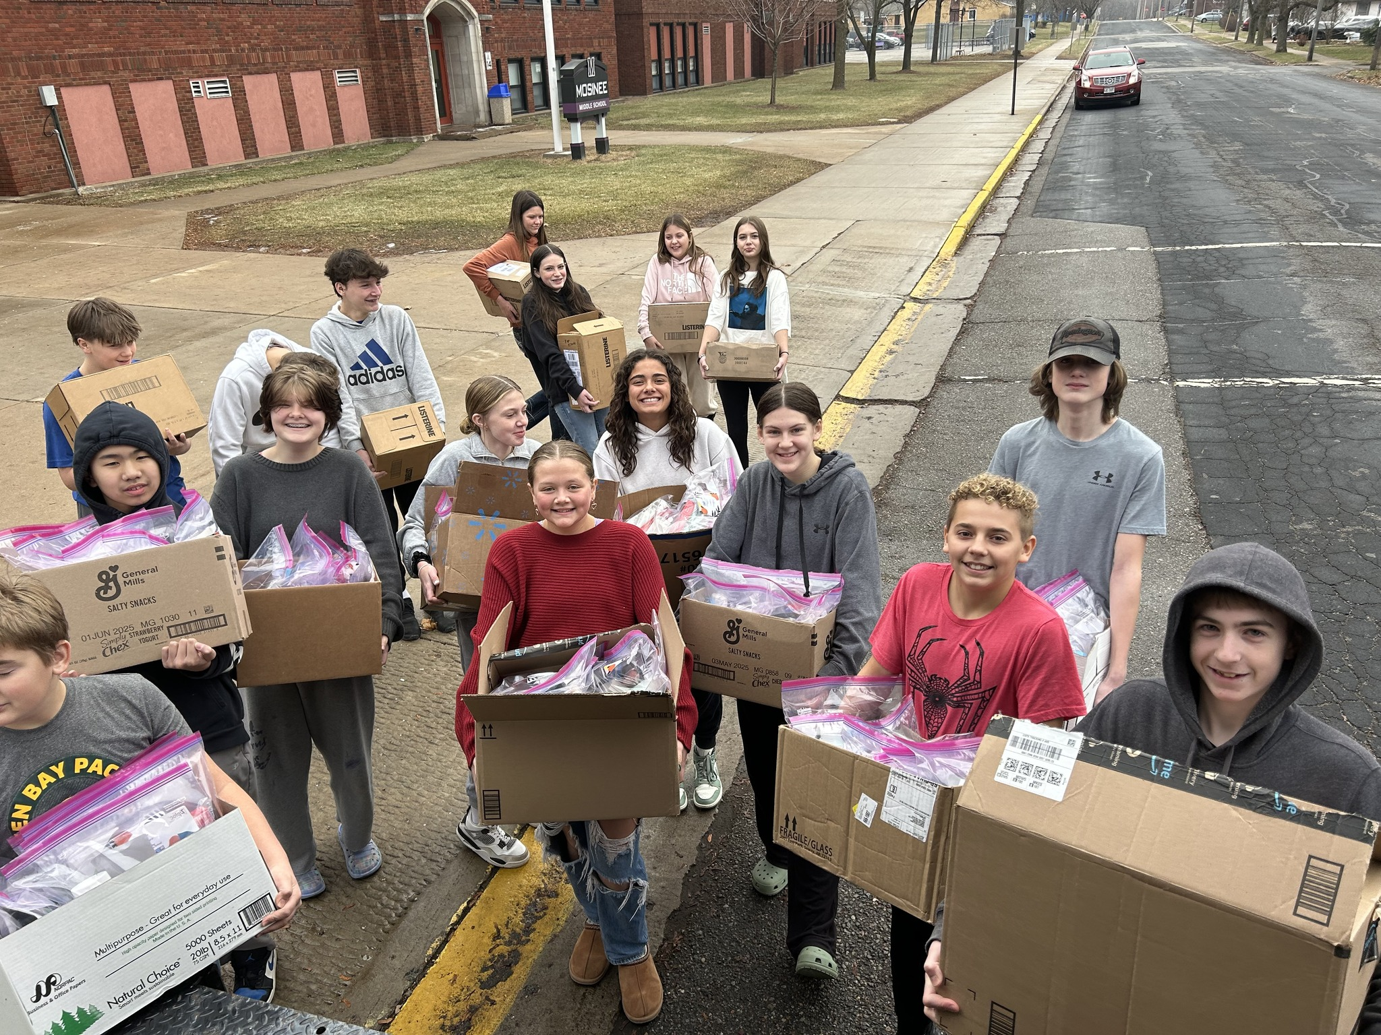
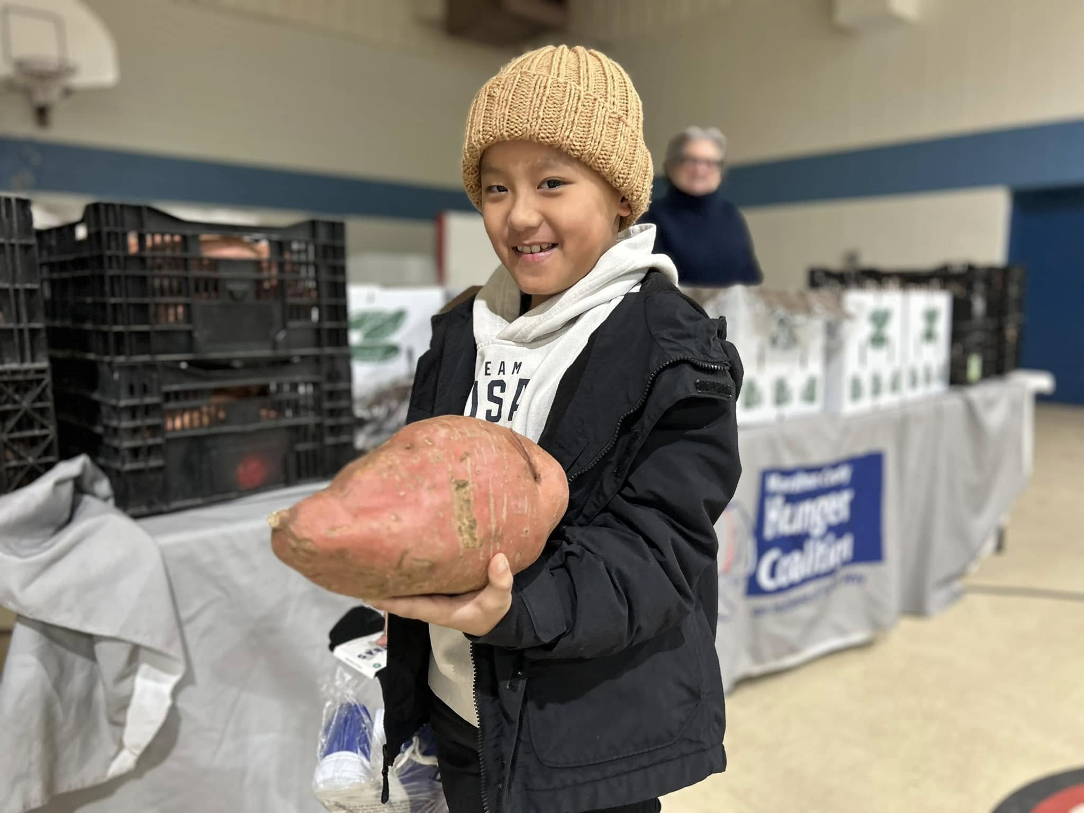
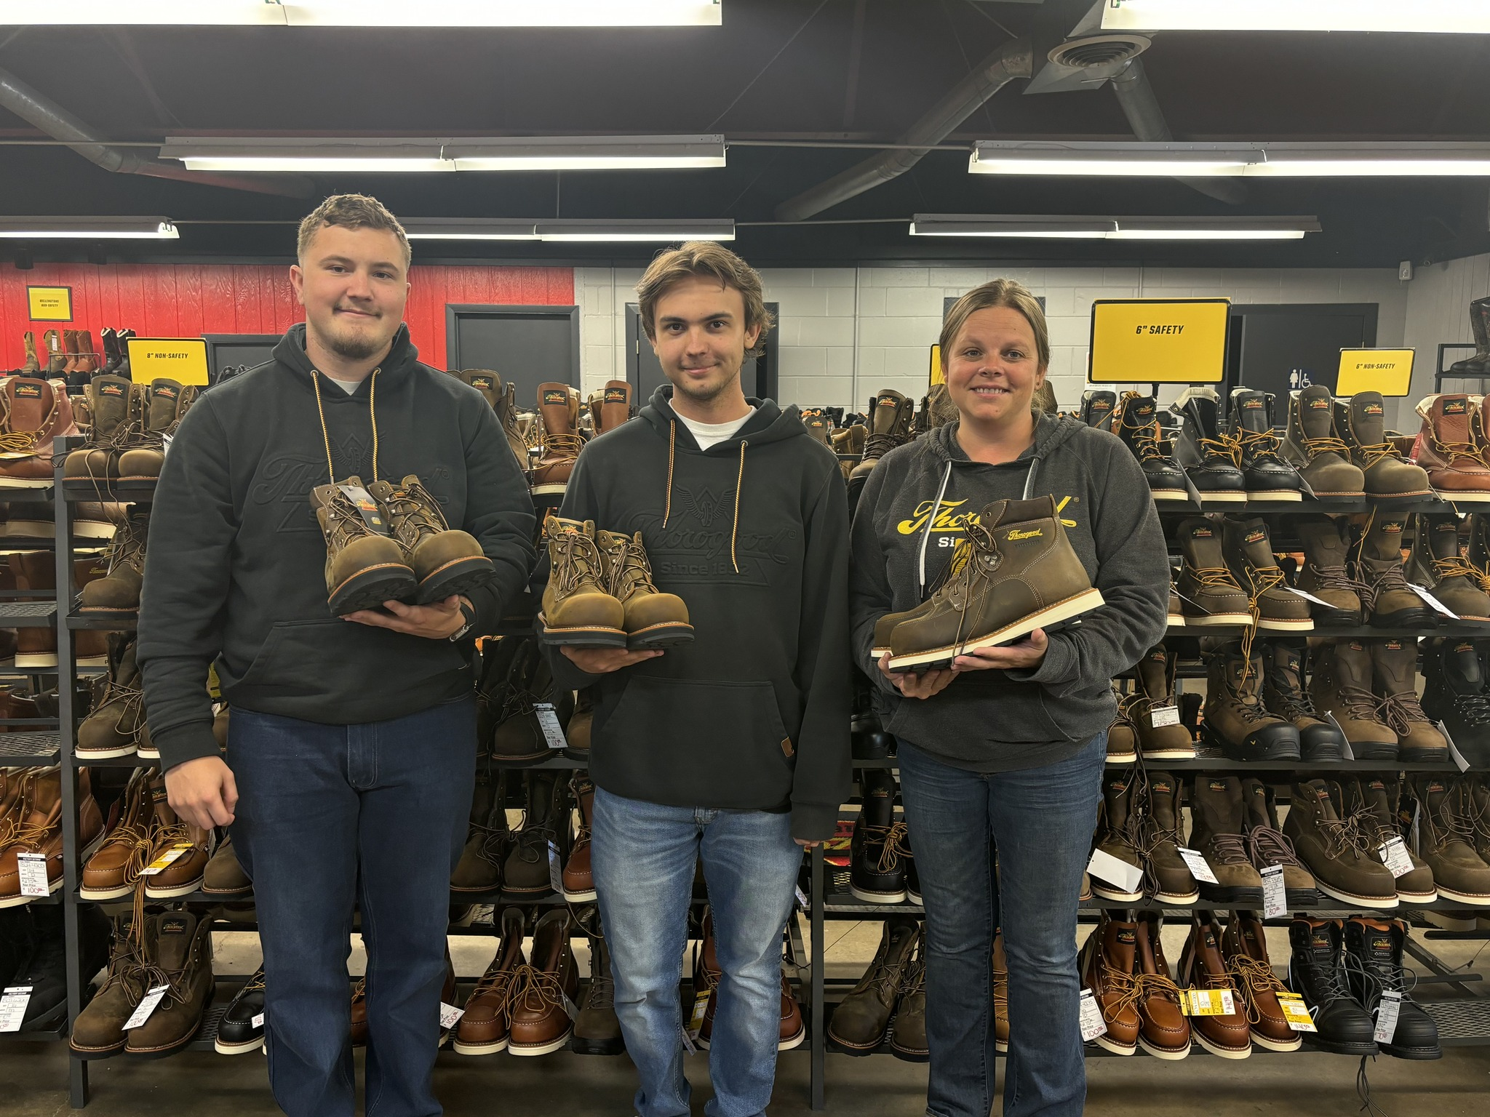

United Way of Marathon County

Slide 2

Mission and Bold Goal
Lift 10,000 Community Members to Financial Stability by 2033.

Slide 3
To achieve this mission, United Way:
Evaluates – we review data, monitor trends, and stay informed about local issues. This information helps us set priorities to guide our investments and initiatives.
Invests – we strategically invest donor dollars in programs that help us achieve our bold goals.
Convenes – we bring together people from businesses, non-profits, schools, government, and the faith community to create a greater collective impact.
Mobilizes – we recruit, promote, and support volunteers within the community.
Connects – we connect people to services and resources, through United Way’s 211.

Slide 4

Who is Alice?
Asset Limited Income Constrained Employed
42% of the population of the City of Wausau falls within ALICE.
Parents working two or three jobs but struggling to pay the bills.
Retirees living on a fixed income and the price of living continues to rise.
83% of the ALICE population is employed or retired.

Slide 5
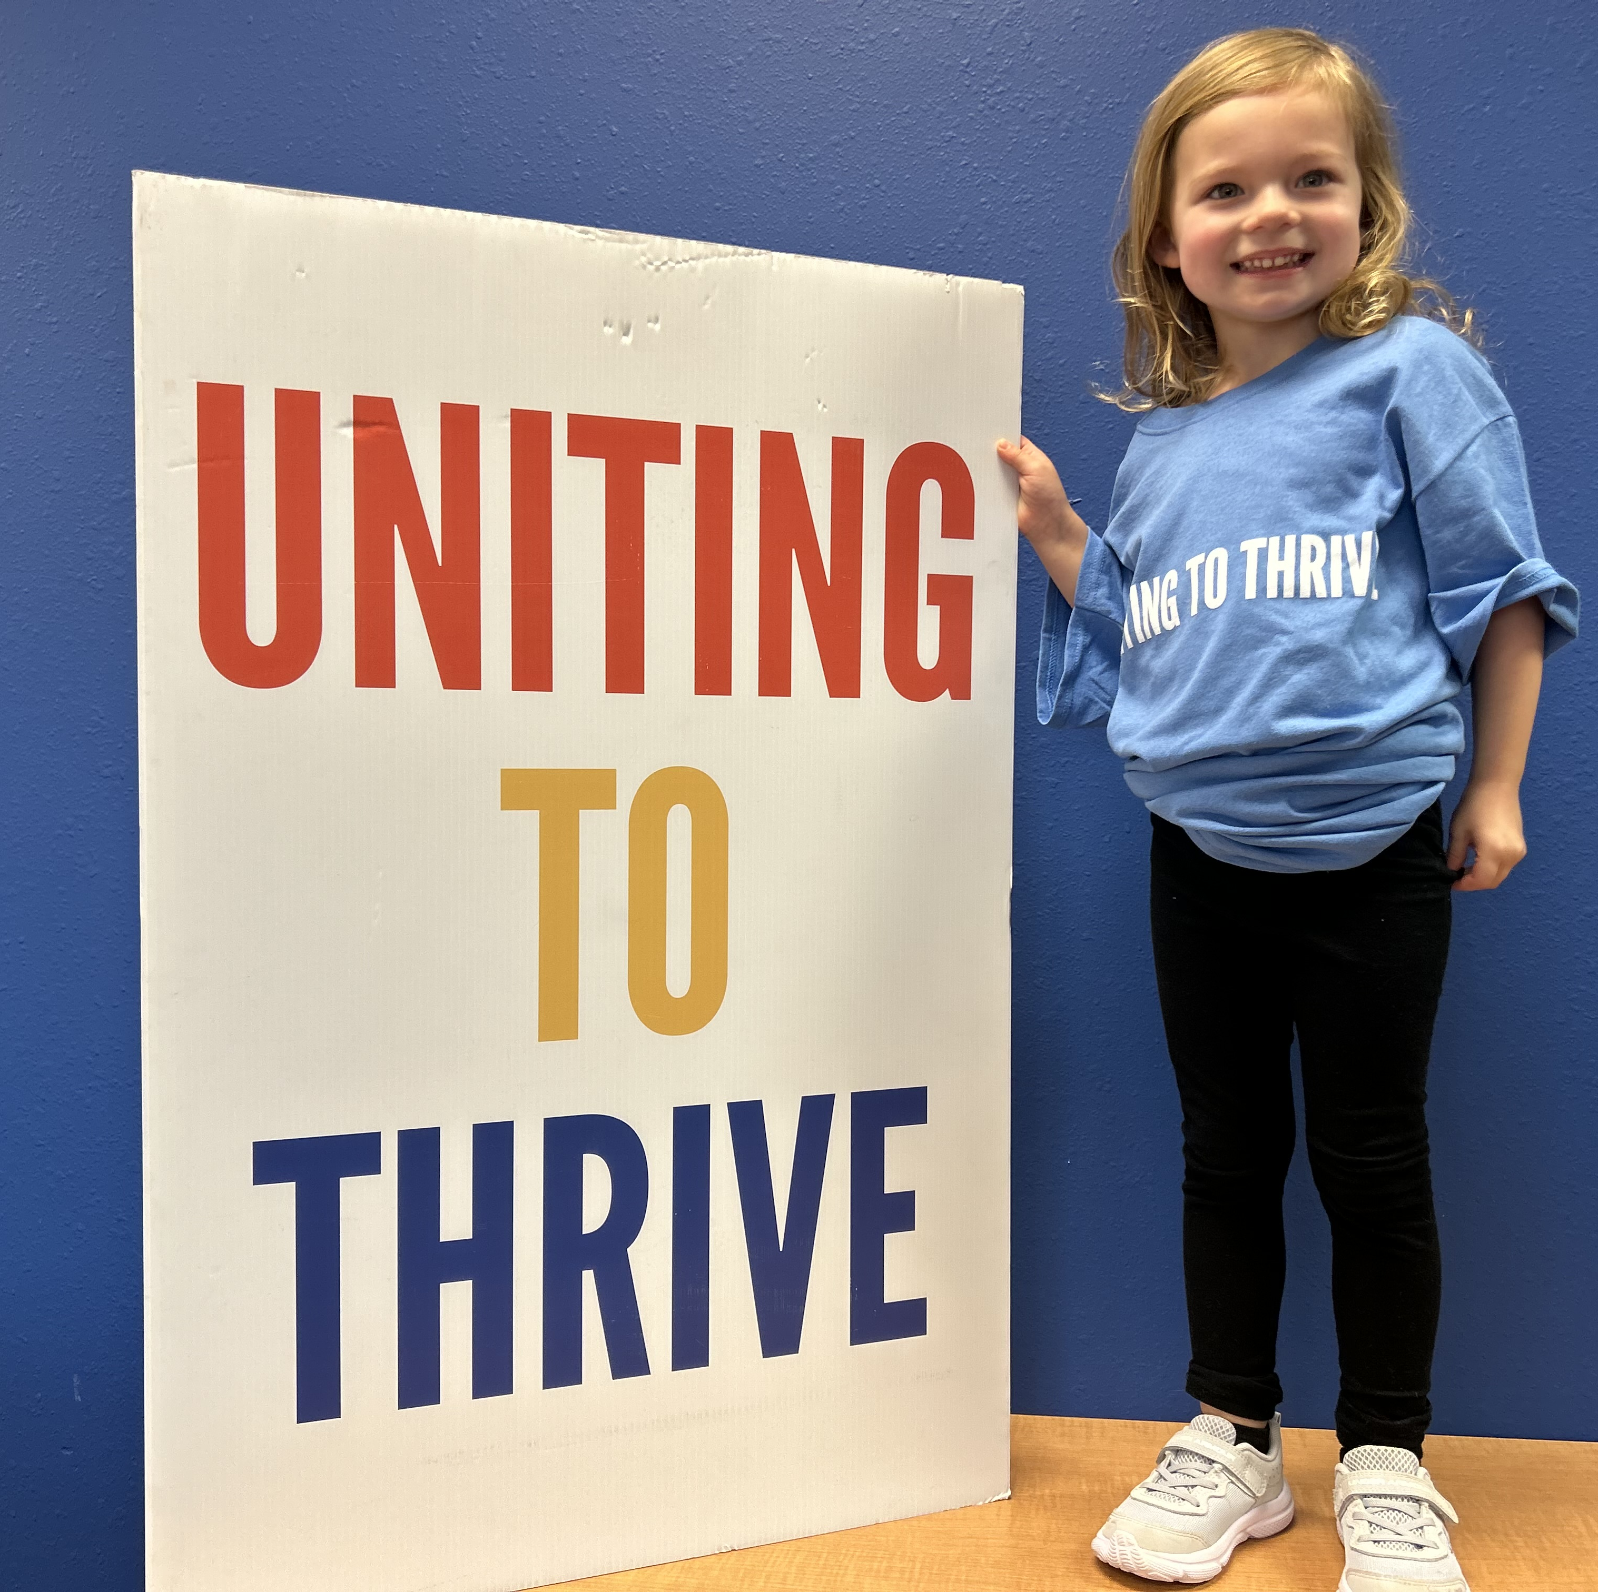
Progress Towards the Bold Goal in 2024
14,209 Individuals Served
3,906 Community Members lifted to financial stability
5,763 referrals made to other services helping individuals continue their path to financial stability

Slide 6
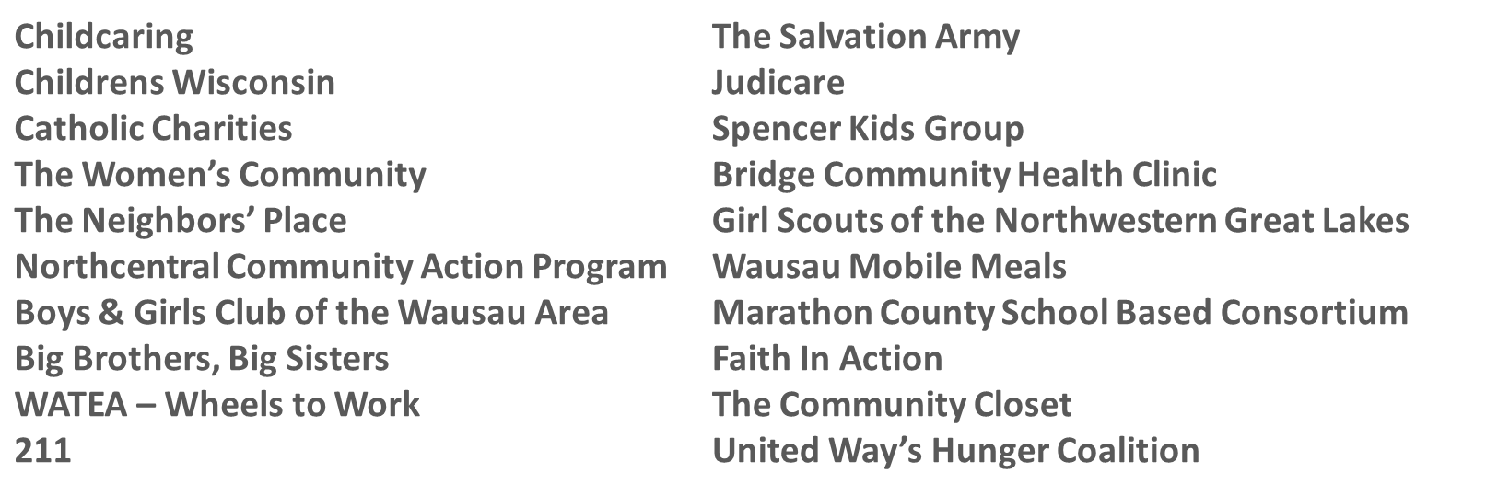
Community Investments
  $1.8 million Sustainable Funding

Slide 7
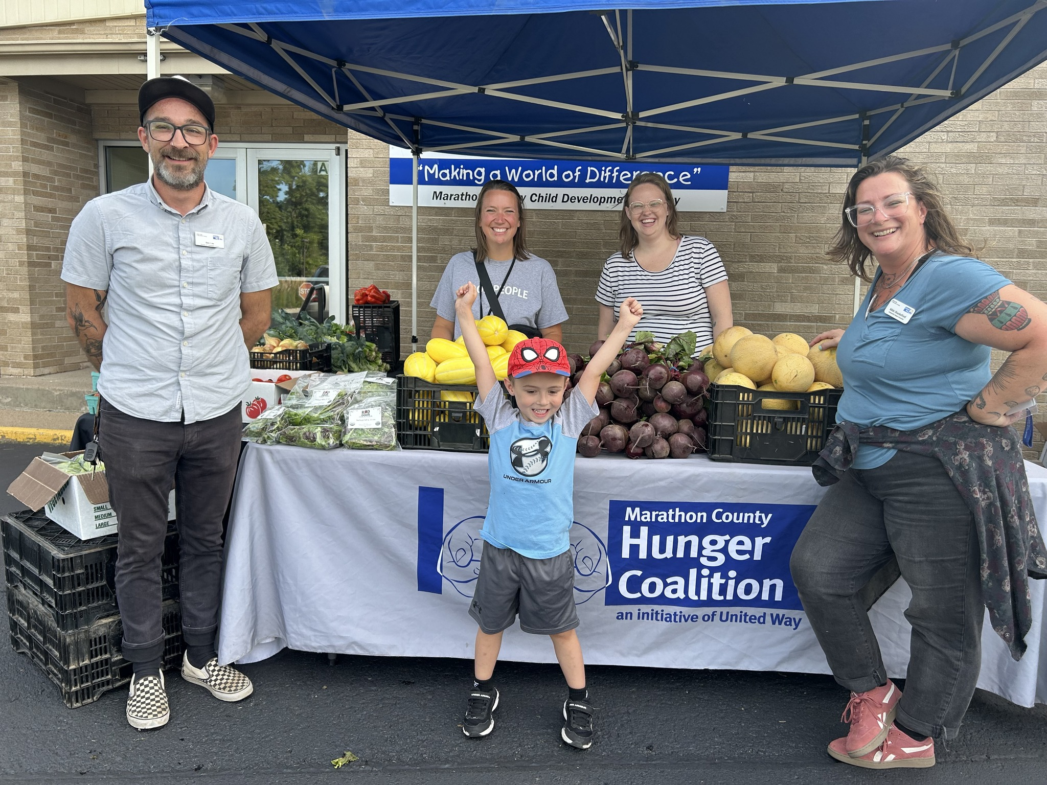
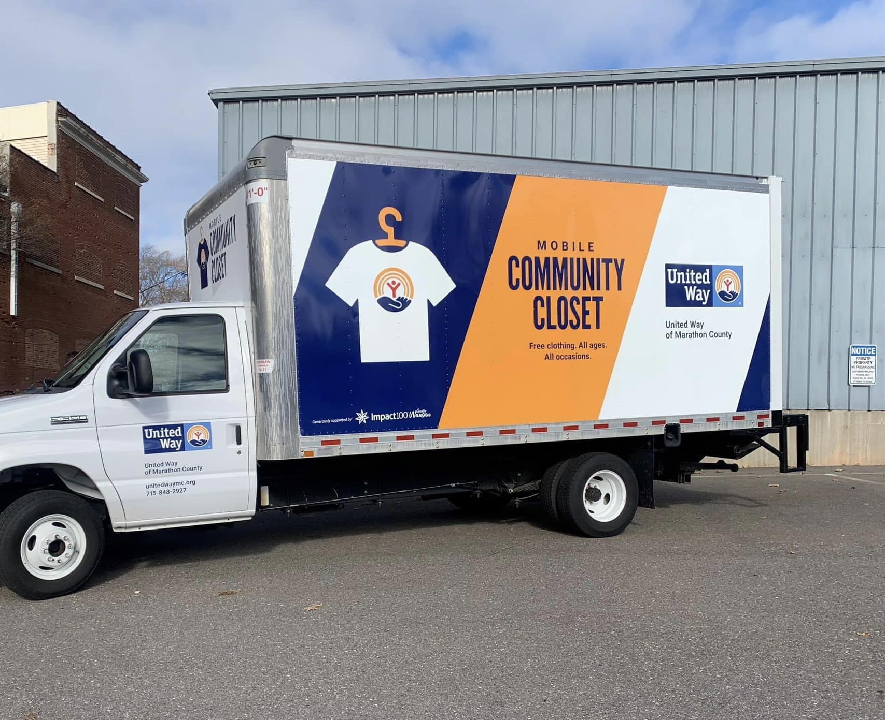
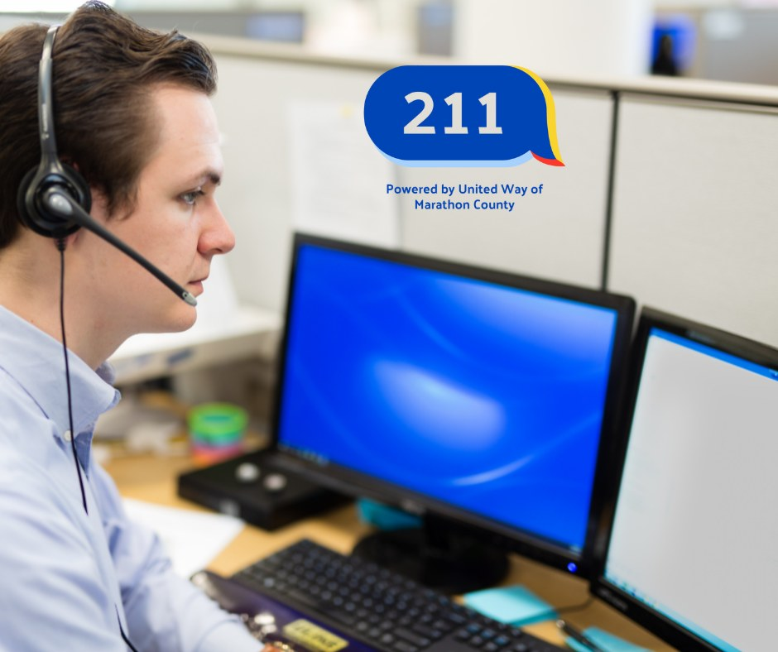
2024 Direct Services
200 boxes of fresh produce were distributed every week to community members who did not have access to healthy foods.
The Community Closet and Mobile Closet served 3,866 individuals in 1,283 households through 7,962 visits.
United Way's 211 answered 4,134 calls for help from Marathon County residents, providing 10,025 referrals.

Slide 8
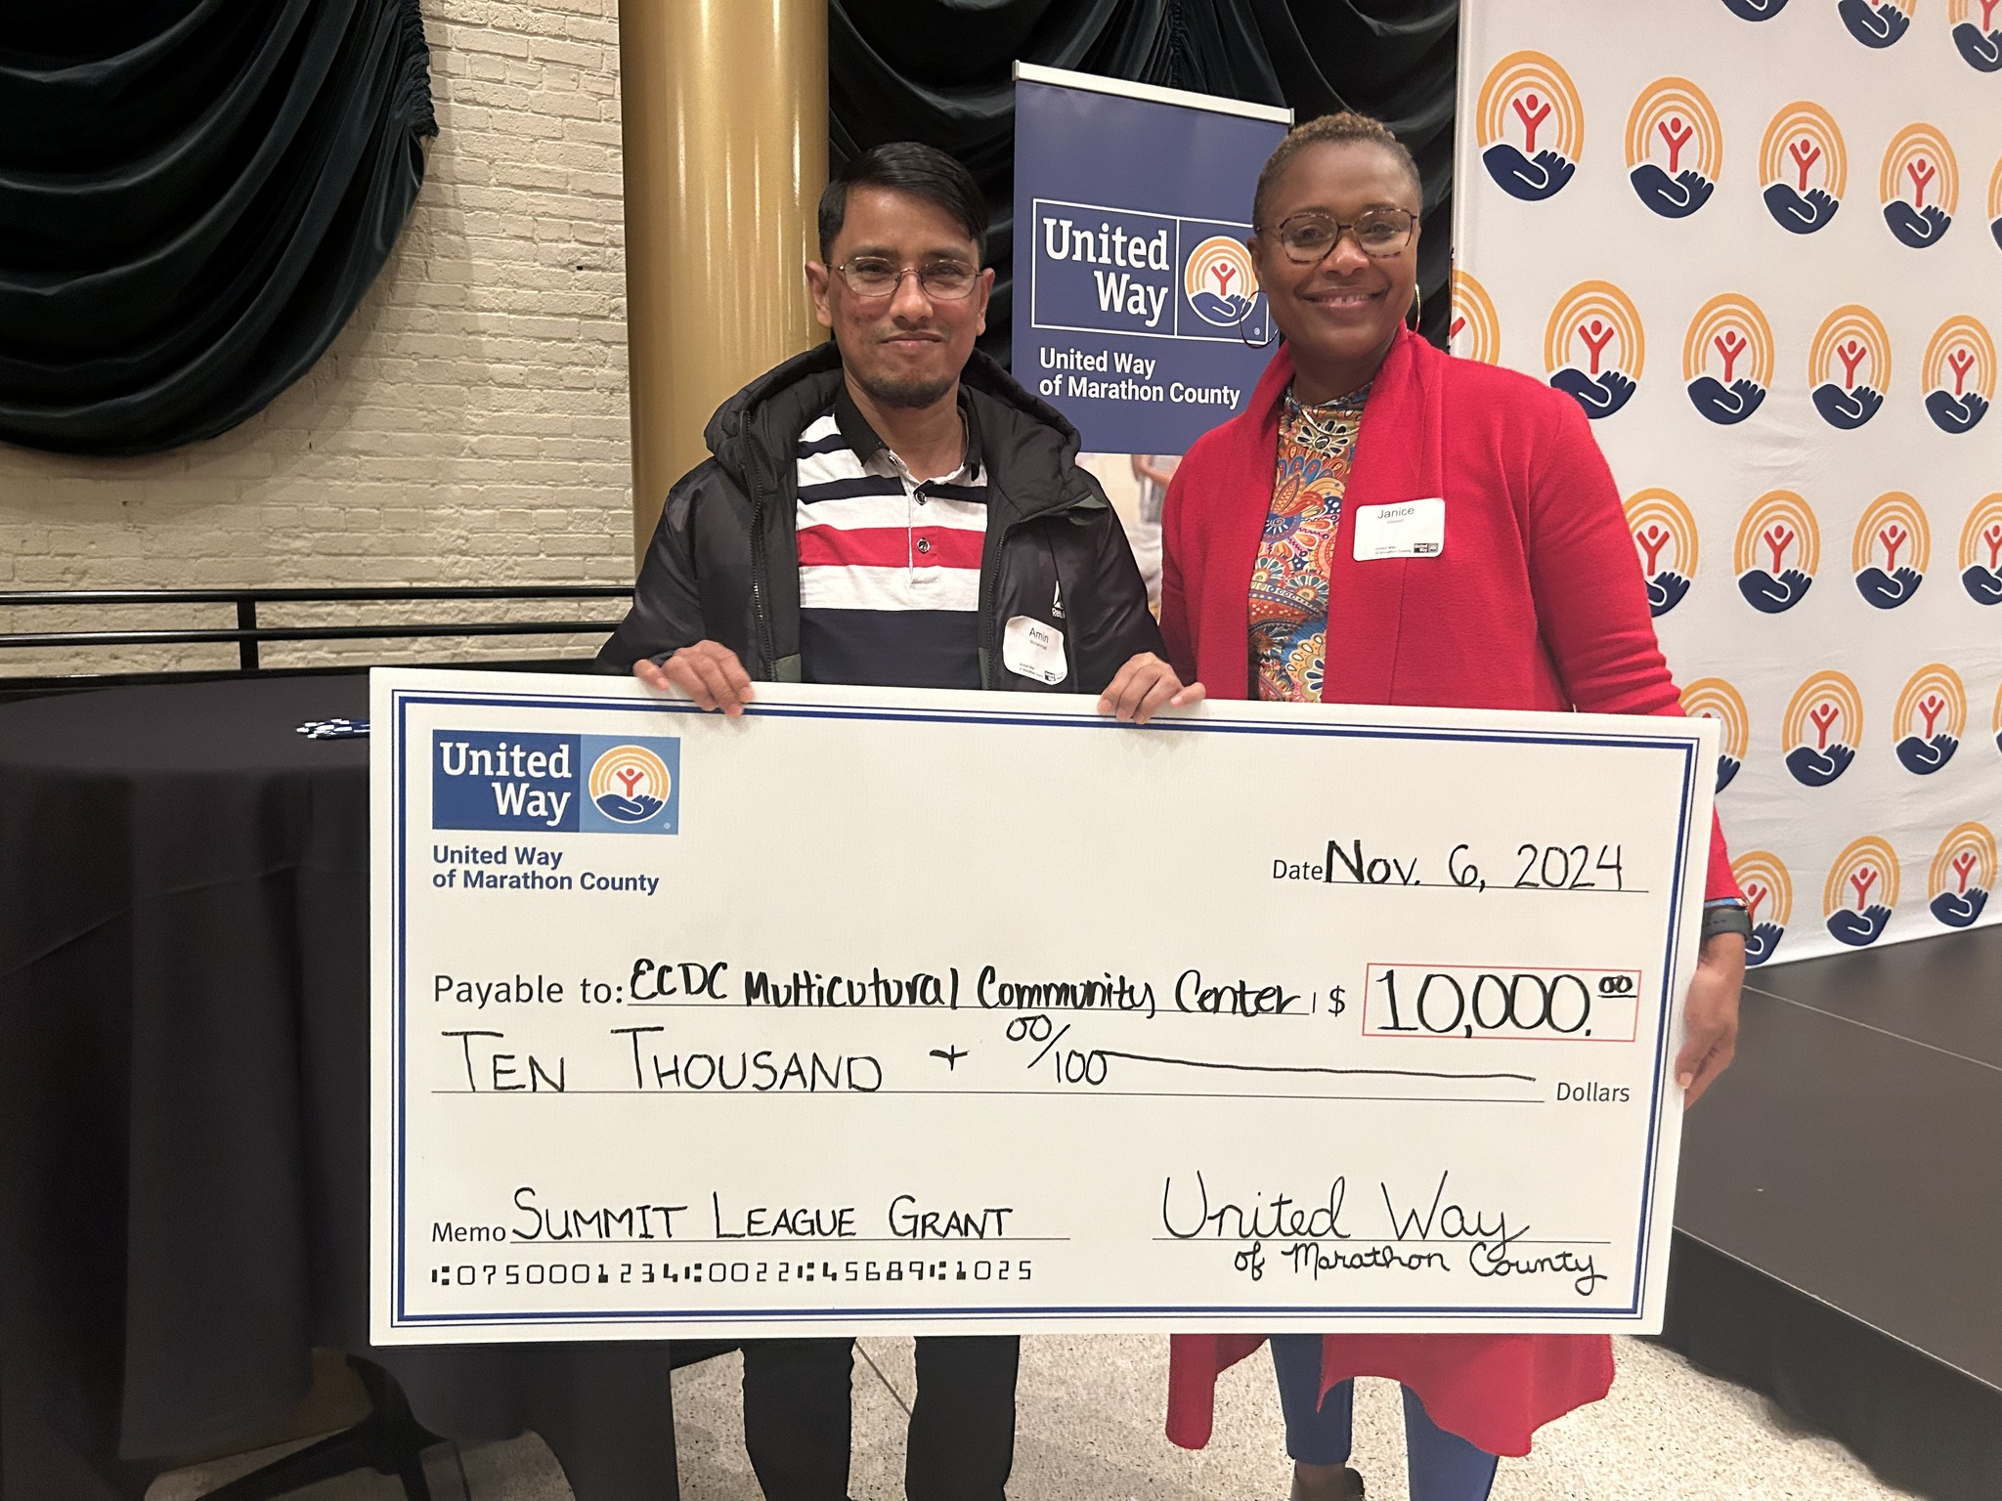
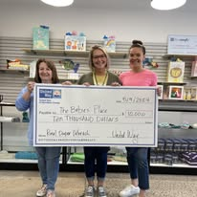
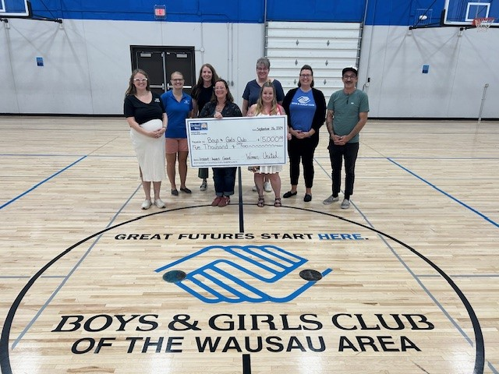
Instant Impact Grants
This specific grant opportunity addresses immediate needs or projects in our community that help us achieve our Bold Goal to lift 10,000 community members to financial stability.
$132,000 given out in two years to 15+ non-profits

Slide 9
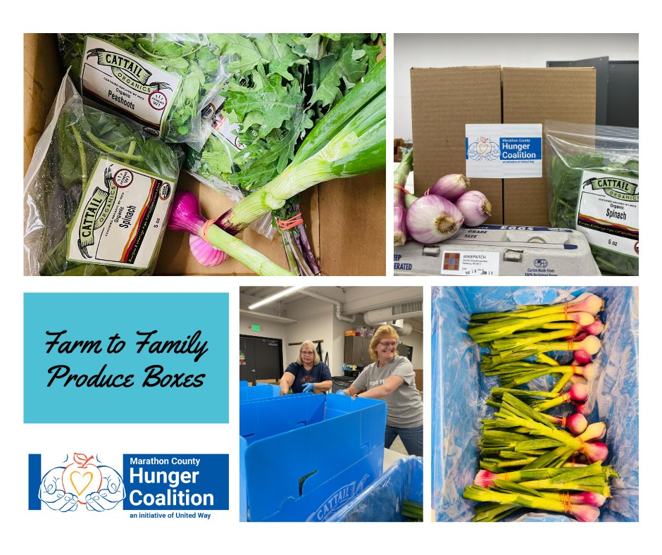
The Marathon County Hunger Coalition
The Coalition works with numerous pantries from around the county to provide nutritious food throughout the year.
Mobile Food Pantries
Community Supported Agriculture (CSA) boxes bought from local farmers. Red Door Family Farms and Cattail Organics bring nutritious food to tables in our area, connecting those in need with fresh, locally-grown produce. Partnering with local farms and offering fresh, locally grown produce allows 100% of donated funds to stay in the community.

Slide 10

Allison and her husband are both employed but have had a rough couple of months and were in need of assistance with rent, medical bills, and prescriptions. They had already applied for assistance from a few programs but were denied due to their income being too high. Allison reached out to 211 for assistance and was able to get information on a number of resources that would help meet their needs. Upon follow-up, Allison shared that they had received the prescription help immediately and were in the process of receiving help with rent.

Slide 11
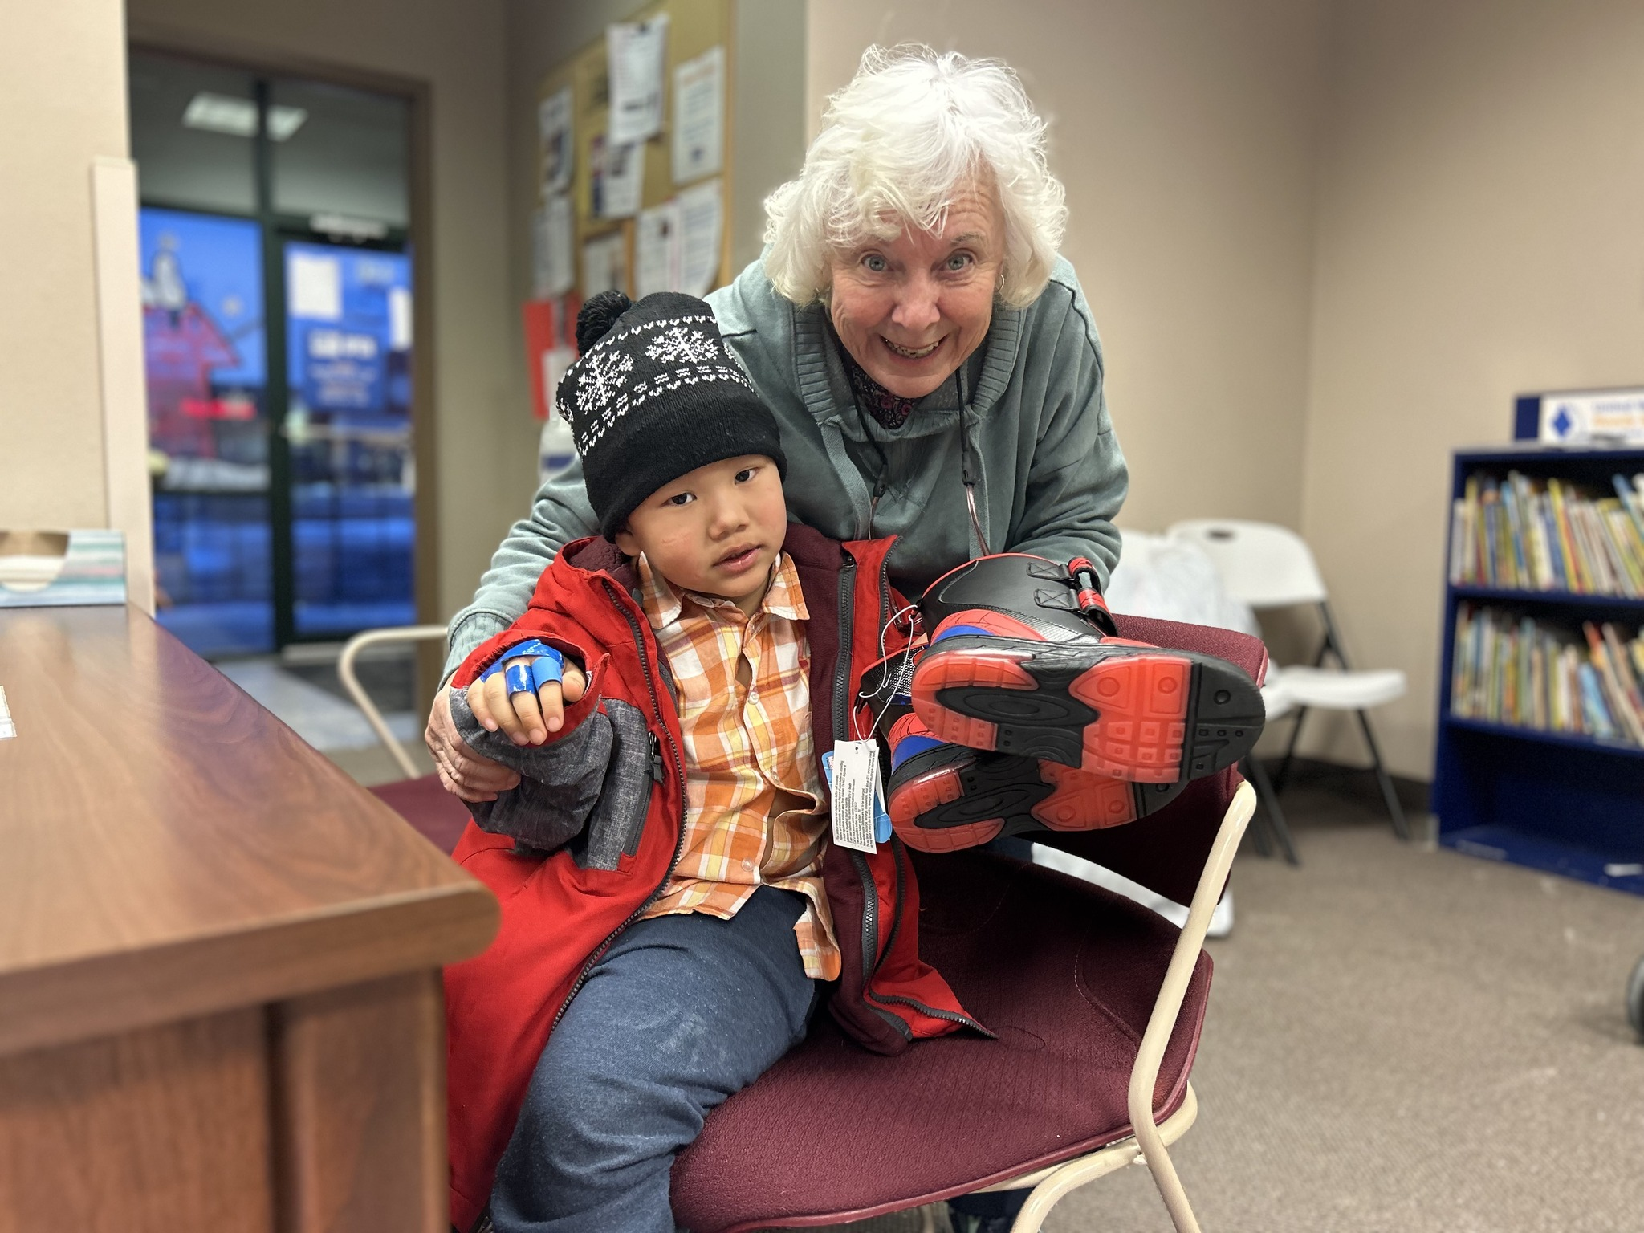
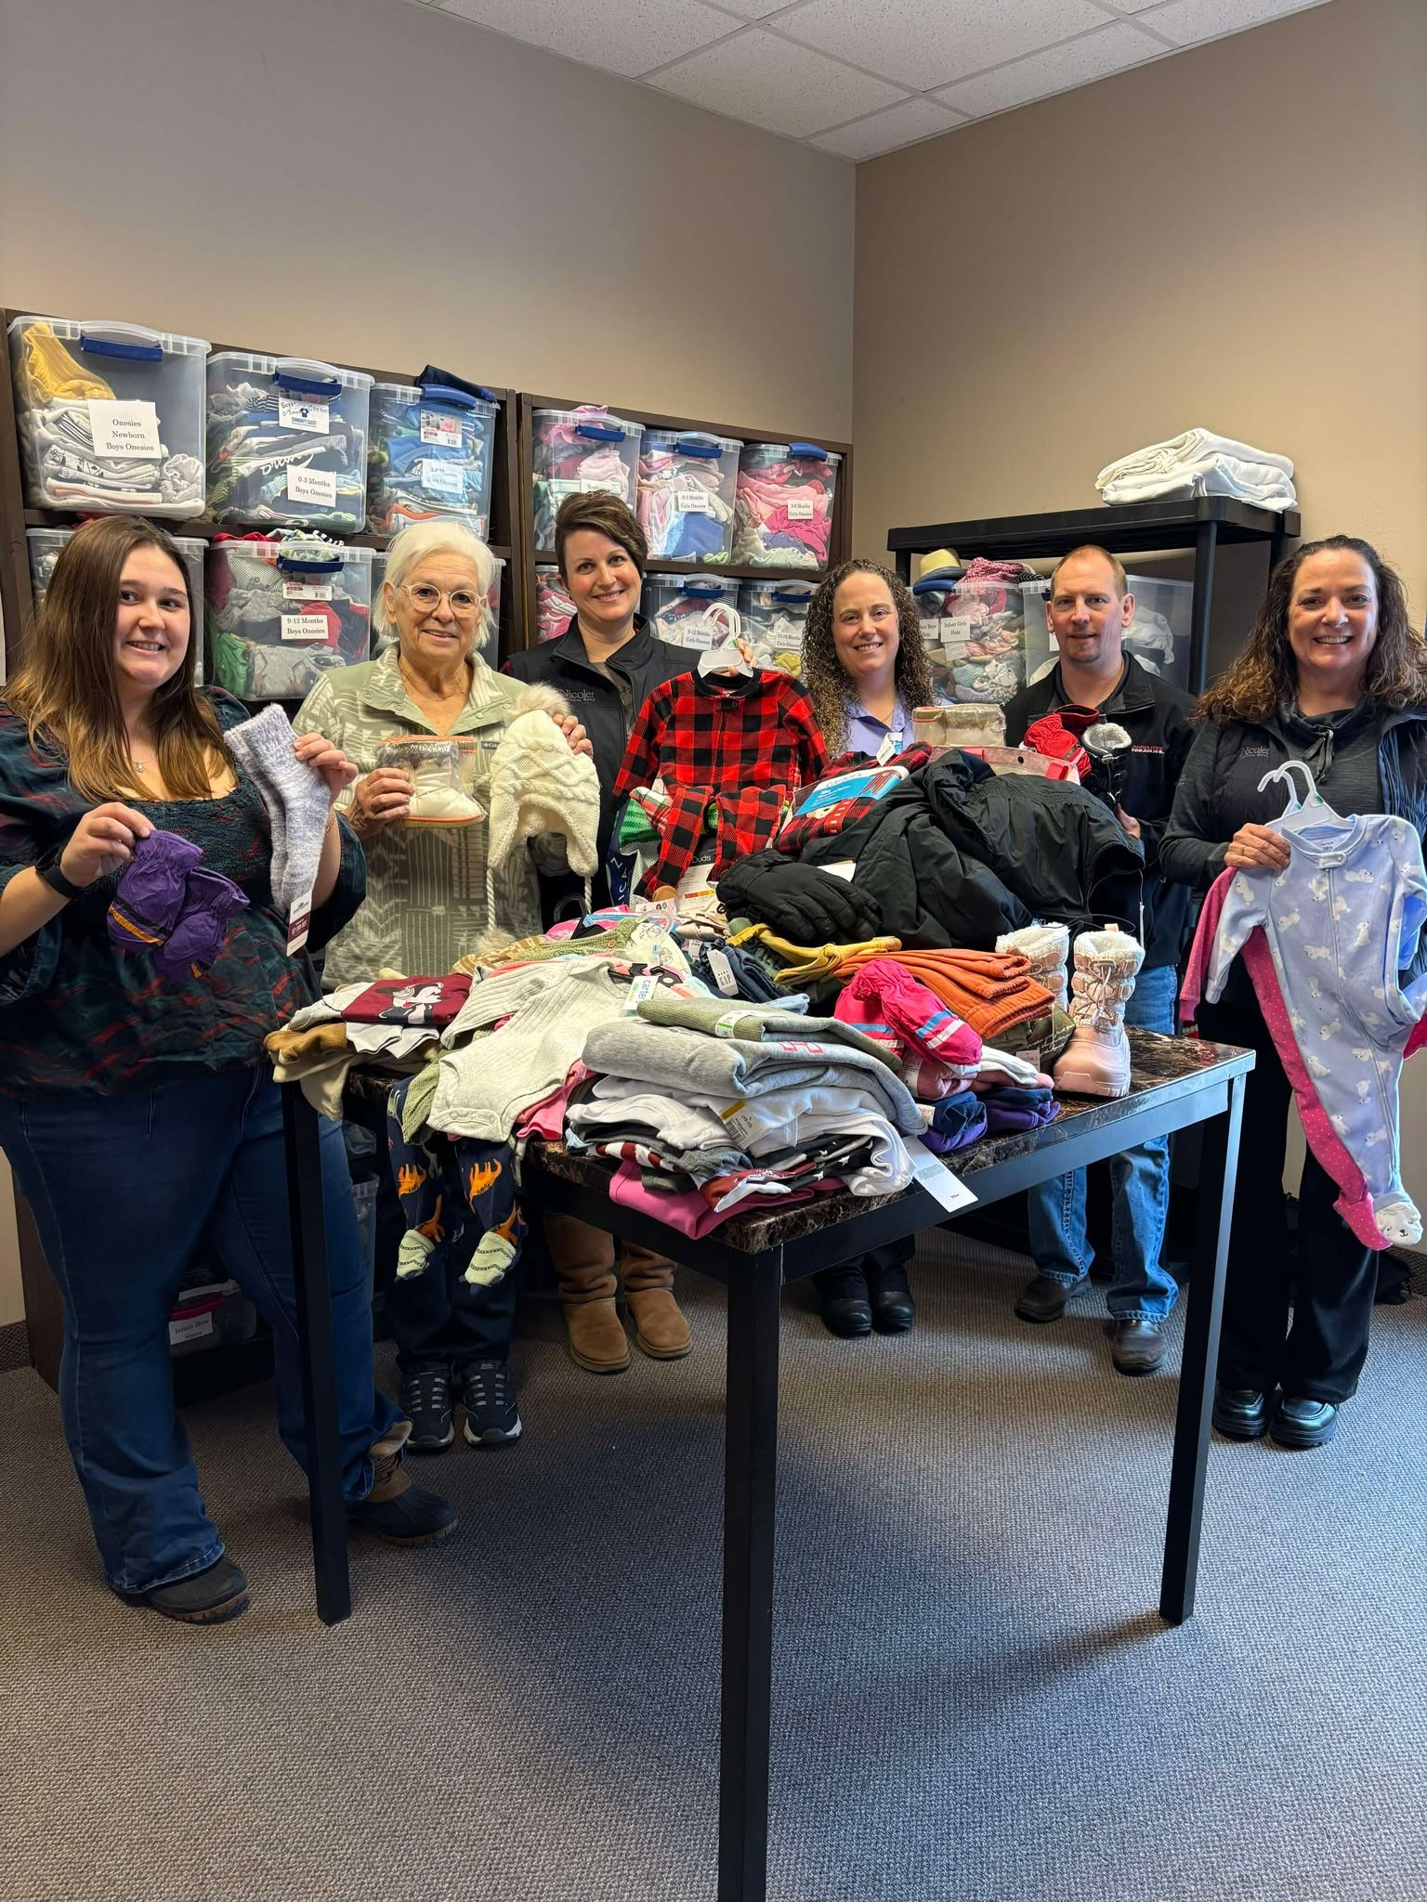
Community Closets
United Way Community Closet is a volunteer-run, donation-driven project. It is housed in the same building as the United Way office, in space donated by Ghidorzi Companies.
The Mobile Community Closet will allow United Way to bring clothes to families at schools, non-profit organizations, and rural communities. This will remove the transportation barrier and time needed to reach the United Way office.
•The United Way Community Closets have a significant impact, helping individuals and families overcome barriers that stand in the way of their success. For many struggling financially, a little help with clothing can make a big difference. The entire family can receive clothing at no cost!
DONATION INTAKE HOURS
Wednesdays: 1 pm – 4 pm
Fridays: 9 am – 12 pm

Slide 12
Volunteer
First/Third Thursdays: We offer one-time volunteer opportunities on the First and Third Thursdays of each month from 2-4pm. You will spend an afternoon with a small team helping sort clothing donations, arrange the shopping floor, do some light cleaning, and help with special projects that make the Community Closet a better resource for Marathon County families! No experience needed.
Mobile Closet in Mosinee: Up to 3 volunteers needed to help unload Mobile Closet, set up shopping area, assist guests with shopping and reload at the end. Shifts are 11:00am-3:00pm on the following dates: March 13, May 29, July 10, September 11, November 13
Farm to Family Produce Program: Each week of the growing season, the Hunger Coalition purchases produce from Red Door Family Farm and Cattail Organics, both based out of Athens, WI. This produce gets boxed and distributed to agencies in Marathon County. Your team will help pack the fresh, organic produce into 200 boxes that can more easily be distributed. This opportunity occurs from May through November on Tuesday mornings at 10am and is a good fit for individuals or groups of 3-5.

Slide 13

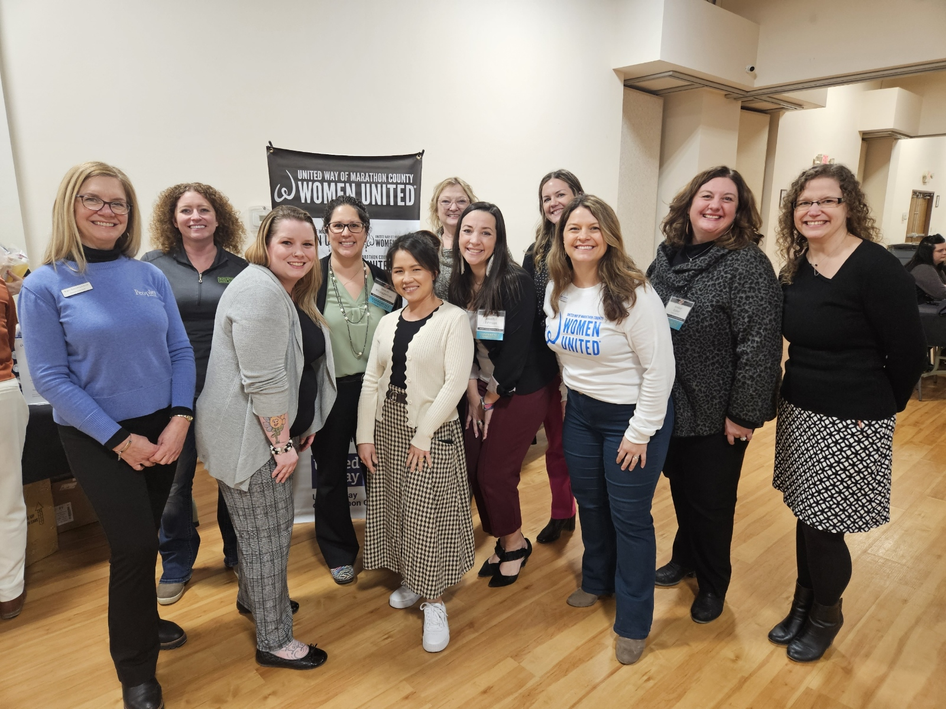
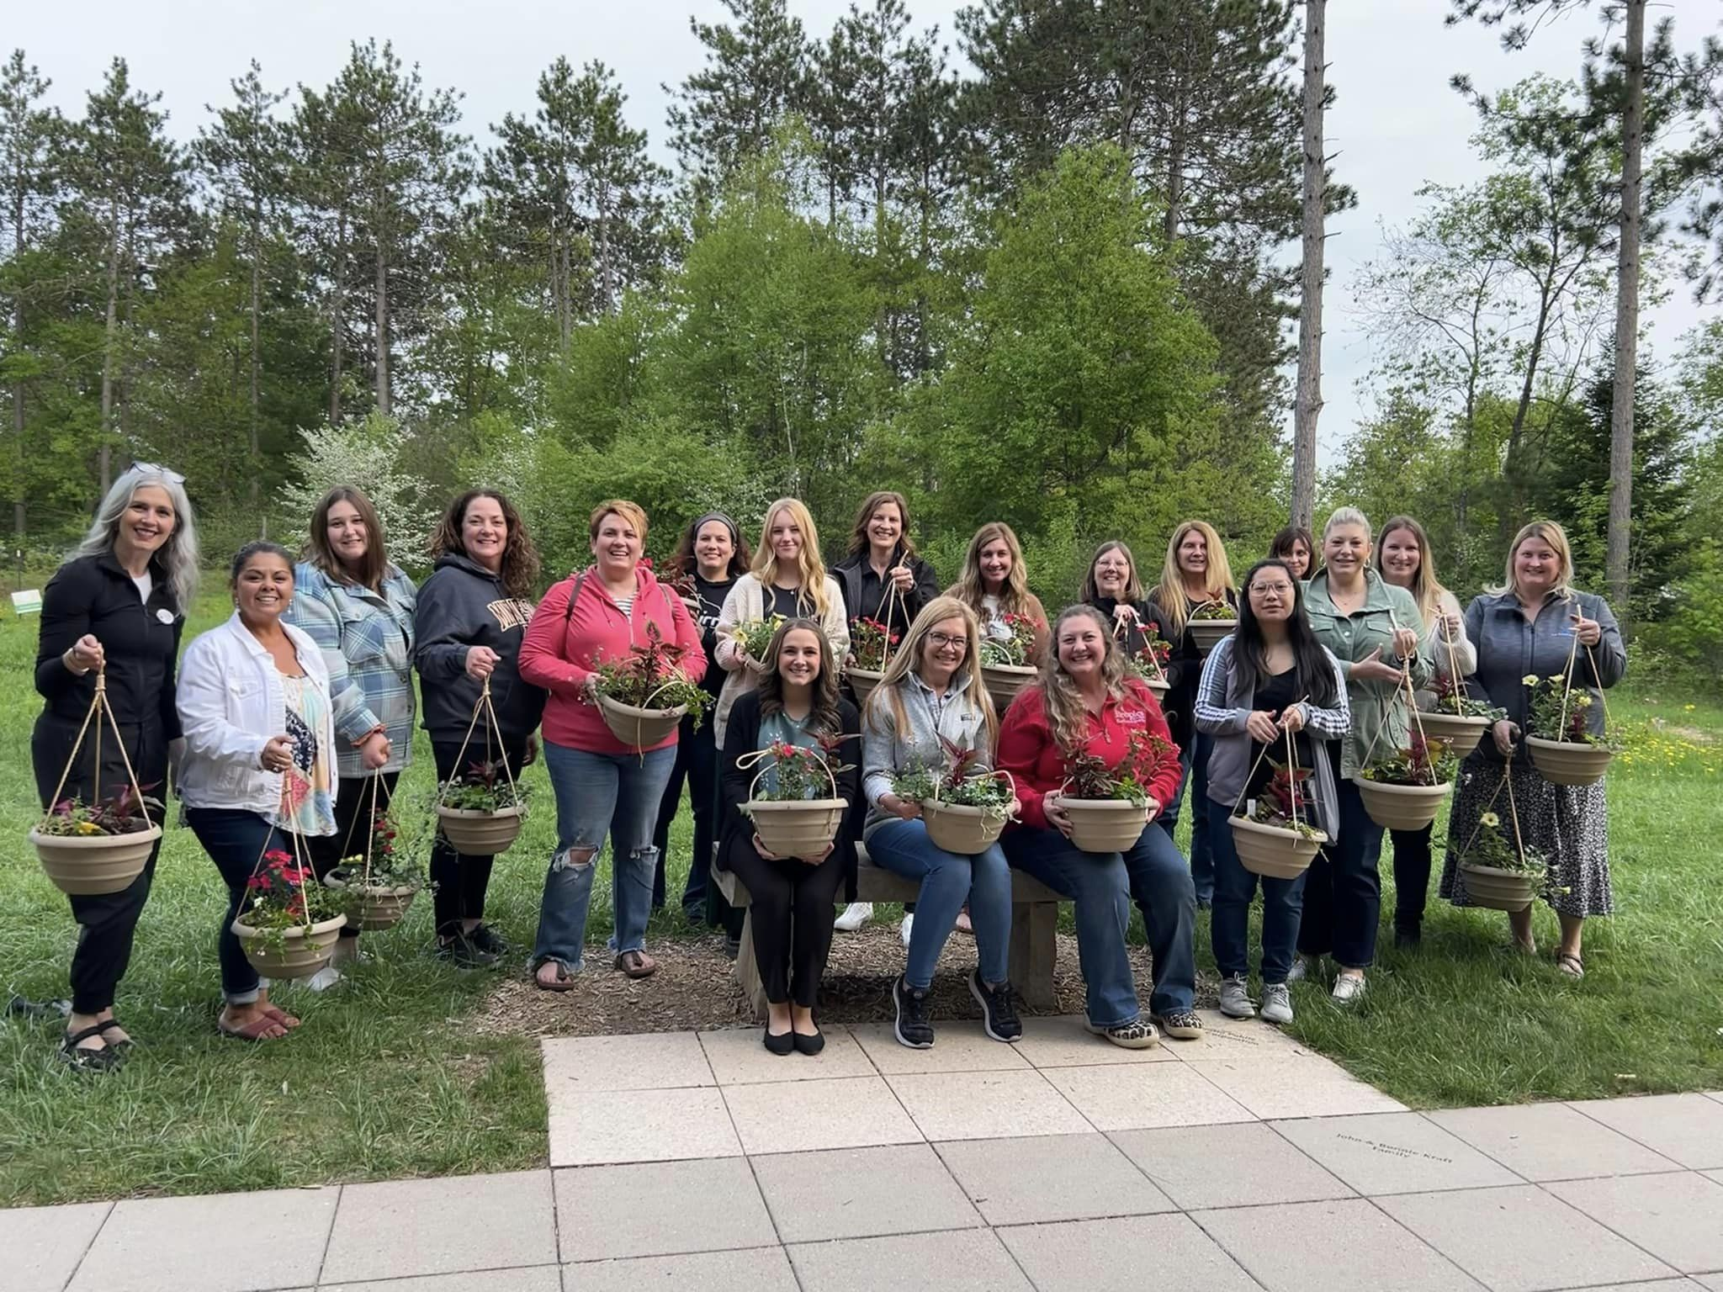
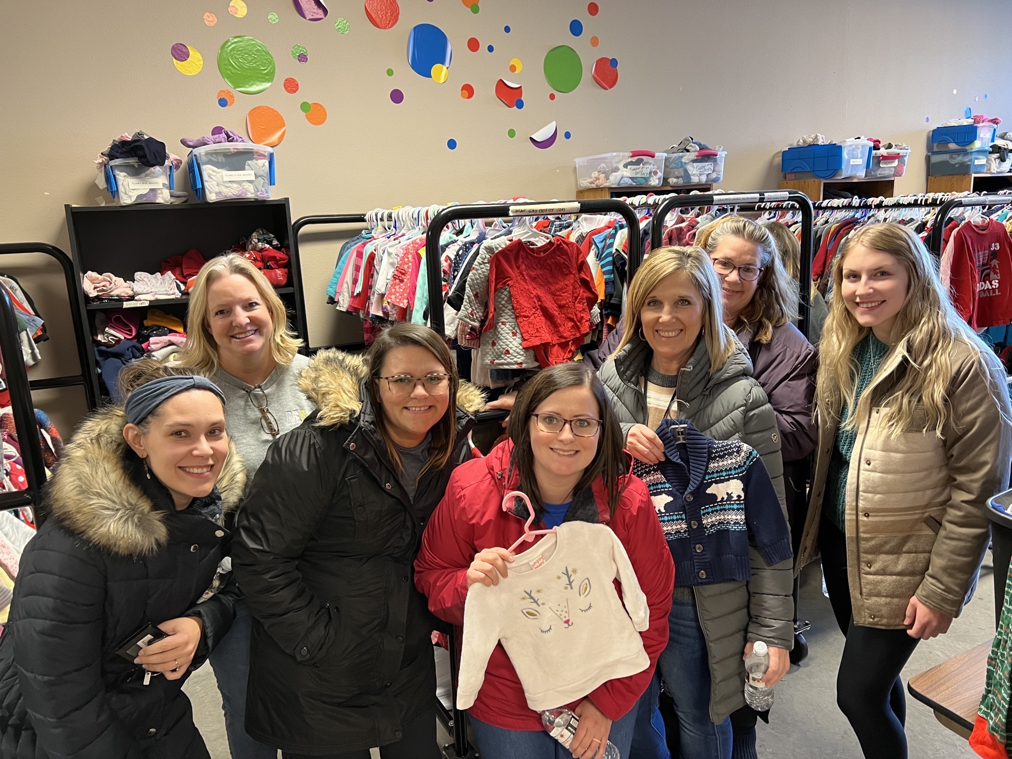
Women United provides members with the opportunity to be part of a dynamic, philanthropic, and fun organization of women leaders who care about our community. It is free to join!
You can attend events, volunteer for projects, join a committee, or graciously contribute financially to support projects.

Slide 14

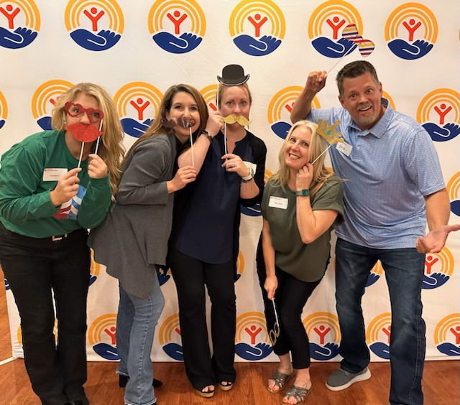
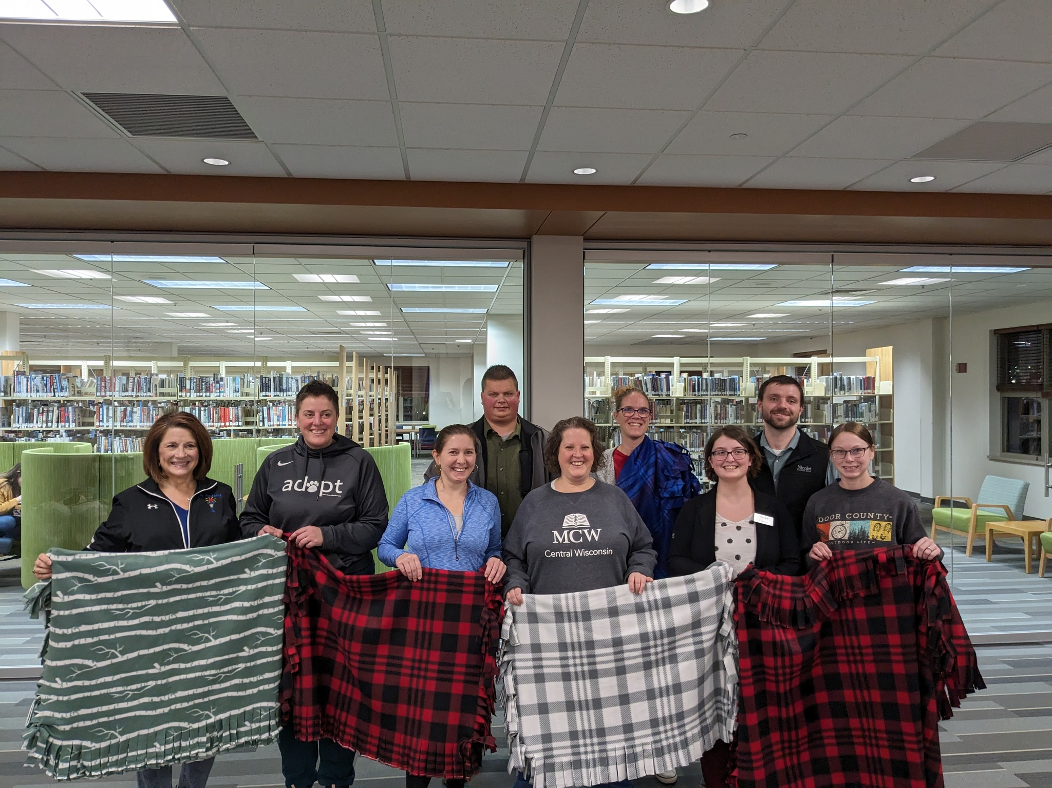
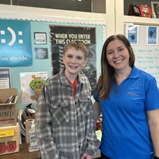
United Way Emerging Leaders is the next generation of professionals who want to make a difference in our community.
Our members enjoy exclusive opportunities to network with business leaders, volunteer for projects, and improve the community we serve. It is free to join!

Slide 15
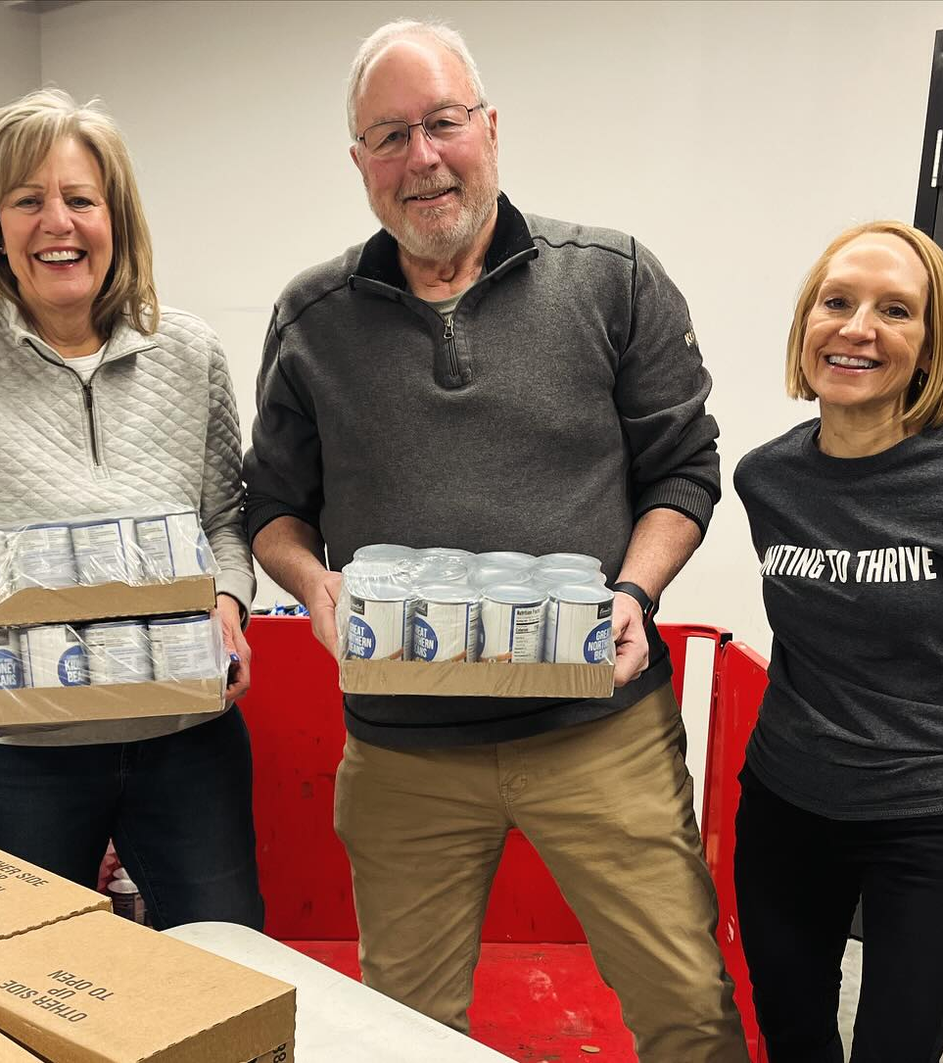
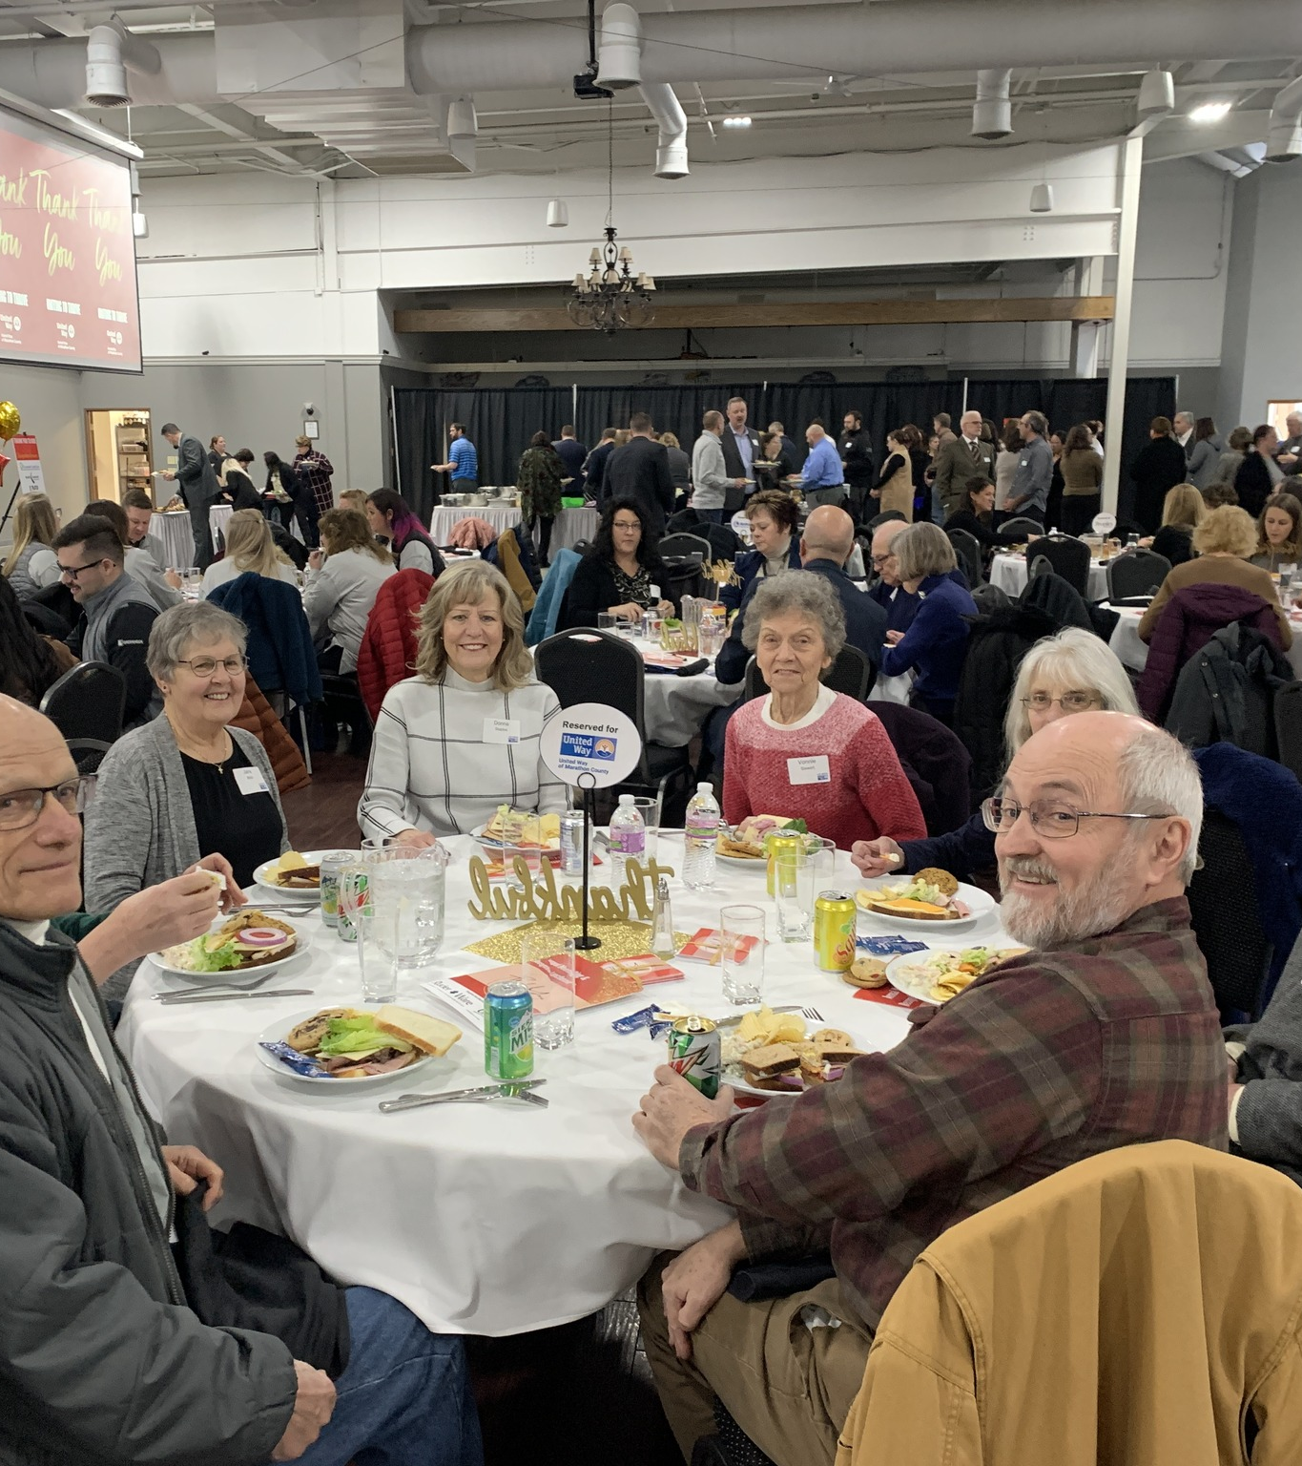
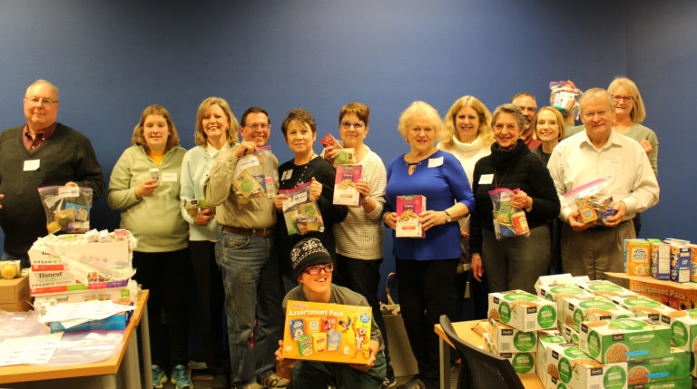
Retire United
United Way Retire United program is designed for individuals who are retired or nearing retirement and recognize the importance that philanthropy and volunteerism play in building a stronger community.
Your lifetime of skills and experiences can benefit future generations. We can help you find a meaningful way to stay engaged in the community.

Slide 16
THANK YOU!
For more information visit: www.unitedwaymc.org
Contact:
Amanda Flannery
Director of Resource Development
715-298-5706
aflannery@unitedwaymc.org
www.unitedwaymc.org

