Slide 1

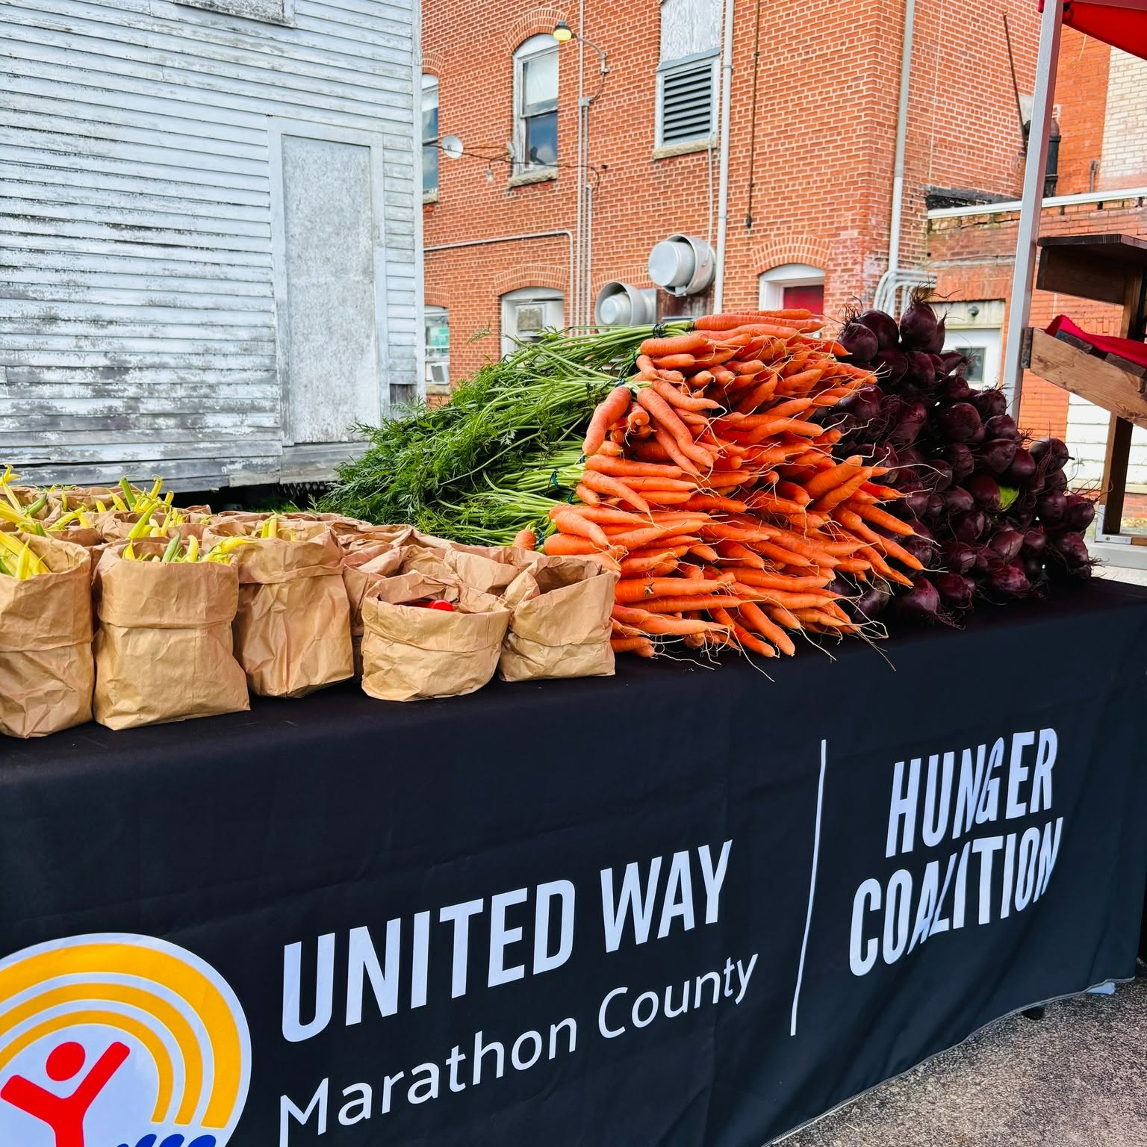
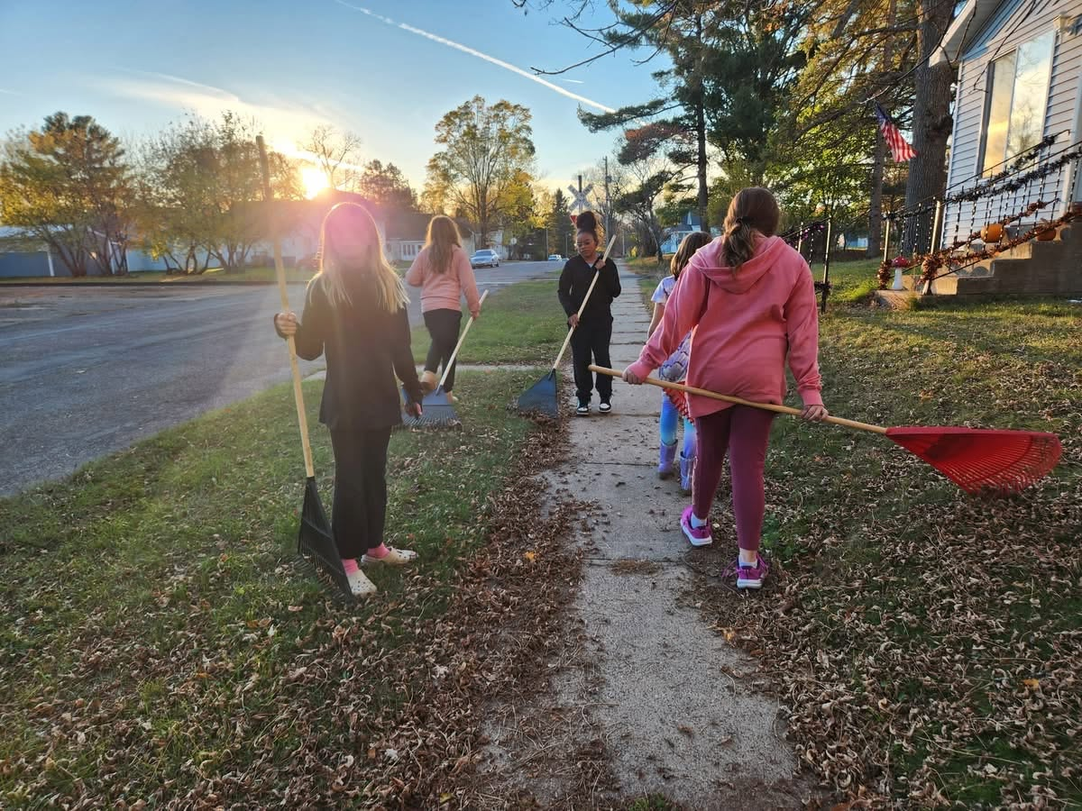
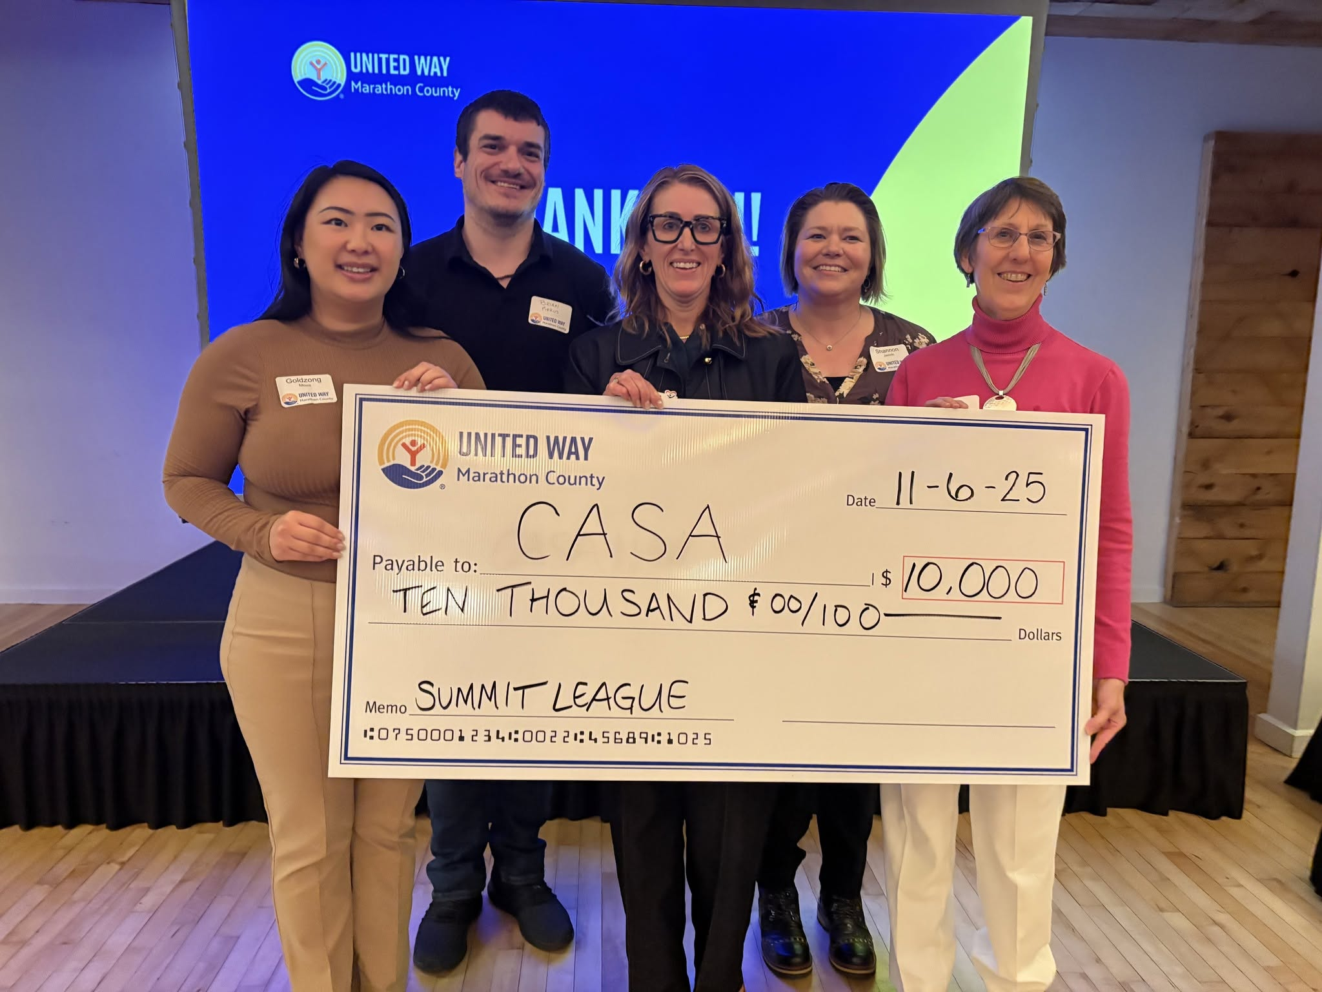

Slide 2


Who is Alice?
Asset Limited, Income Constrained, Employed
Wages fail to keep pace with the rising cost of household essentials
32% of Marathon County residents fall within the ALICE population
Working parents juggling multiple jobs
Retirees living on a fixed income and trying to keep up with rising costs
83% of the ALICE population is working or retired.

Slide 3
Bold Goal:
Lift 10,000 Community Members to Financial Stability by 2033.
Focus Areas:
Basic Needs
Childcare
Behavioral Health
Employment Skills

Slide 4
Community Investments
  $1.7 million Sustainable Funding
Aging and Disability Resource Center of Central Wisconsin – Meals on Wheels
Big Brothers Big Sisters of Northcentral Wisconsin – Mentoring
Boys & Girls Club of the Wausau Area – Wausau Area Elementary Center Program
Bridge Community Health Clinic – Mental Health & Trauma Services; SUD Treatment & Prevention Services
Childcaring, Inc – Good Start Grants
Children's Service Society of Wisconsin (aka Children's Wisconsin) – School Based Mental Health - Integrated Model
Community Center of Hope, Inc. – Bridging the Gap: Nourishing ALICE Families
ECDC - Multicultural Community Center WI – BRIDGE - Building Refugee Independence through Development, Growth and Essential
Faith in Action Marathon County, Inc – FIAMC Essential Support for Seniors
Healthfirst – Healthfirst Community Connections
HOLA, Inc – Abbotsford food pantry; Bilingual community-based case management services
Marathon County DSS – Family Keys
Marathon County School Based Consortium – Marathon County School Based Counseling Consortium
North Central Community Action Program, Inc. – Emergency Housing Assistance Funding
Progress Athens Foundation, Inc. – Athens Area Food Bank Launch
Spencer Kids Group – Spencer Kids Group
St. Vincent de Paul – Getting Ahead
The Girl Scouts – Creating Equitable Pathways into the Girl Scouts Leadership Experience
The Neighbors' Place – More Than Food
The Women's Community, Inc. – Domestic Abuse Services; Sexual Assault Victim Services; Transitional Living Program
Wausau Free Clinic – Wausau Free Clinic
Wausau Mobile Meals – Wausau Mobile Meals
Wisconsin Judicare Inc DBA Judicare Legal Aid – Judicare Community Law Clinic; Judicare Mediation Services
Woodson YMCA – Woodson Y For All Childcare Fund

Slide 5
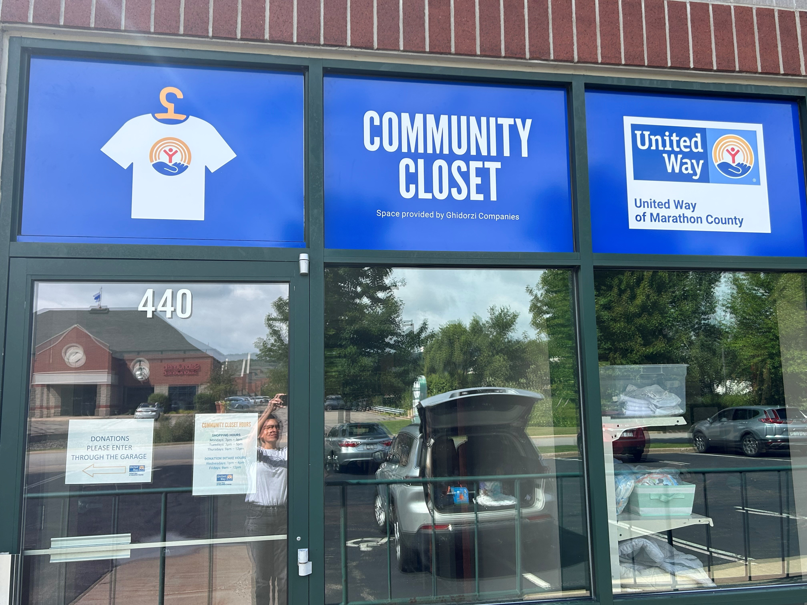
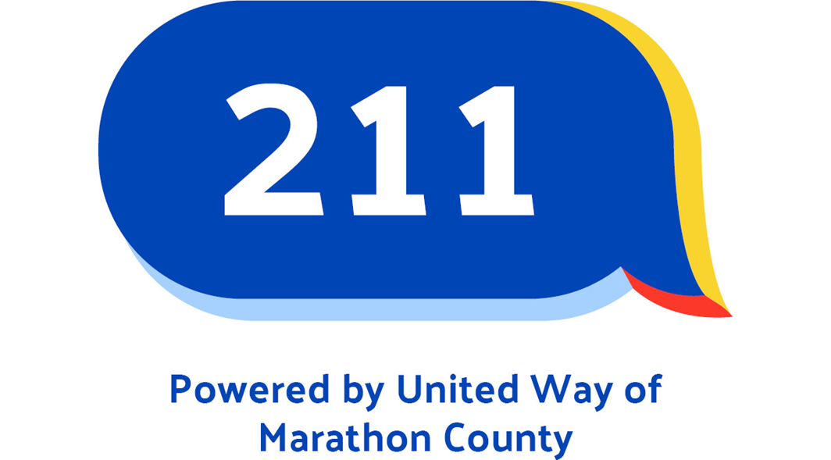
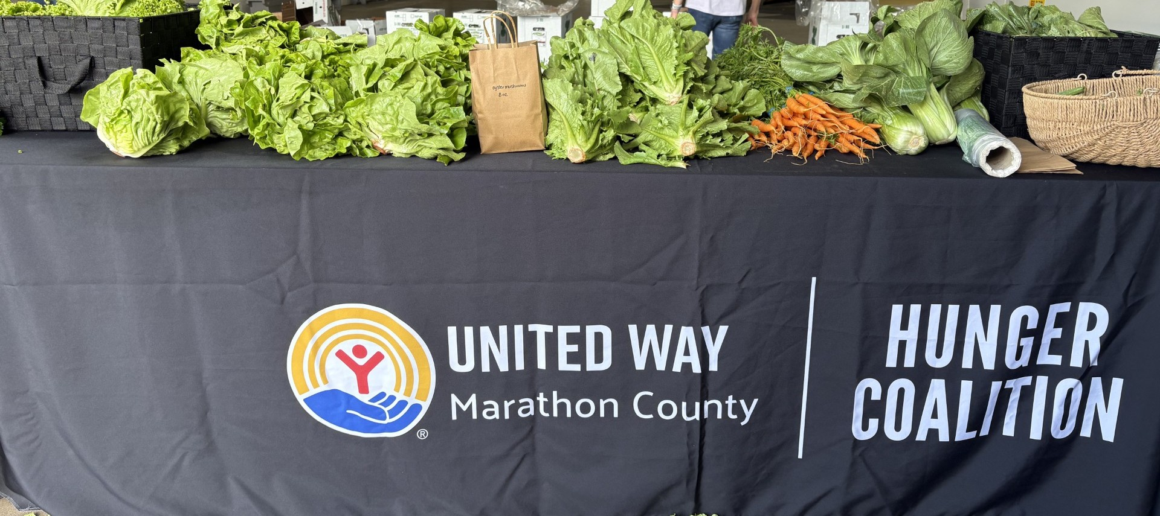
Direct Service Programs

Slide 6
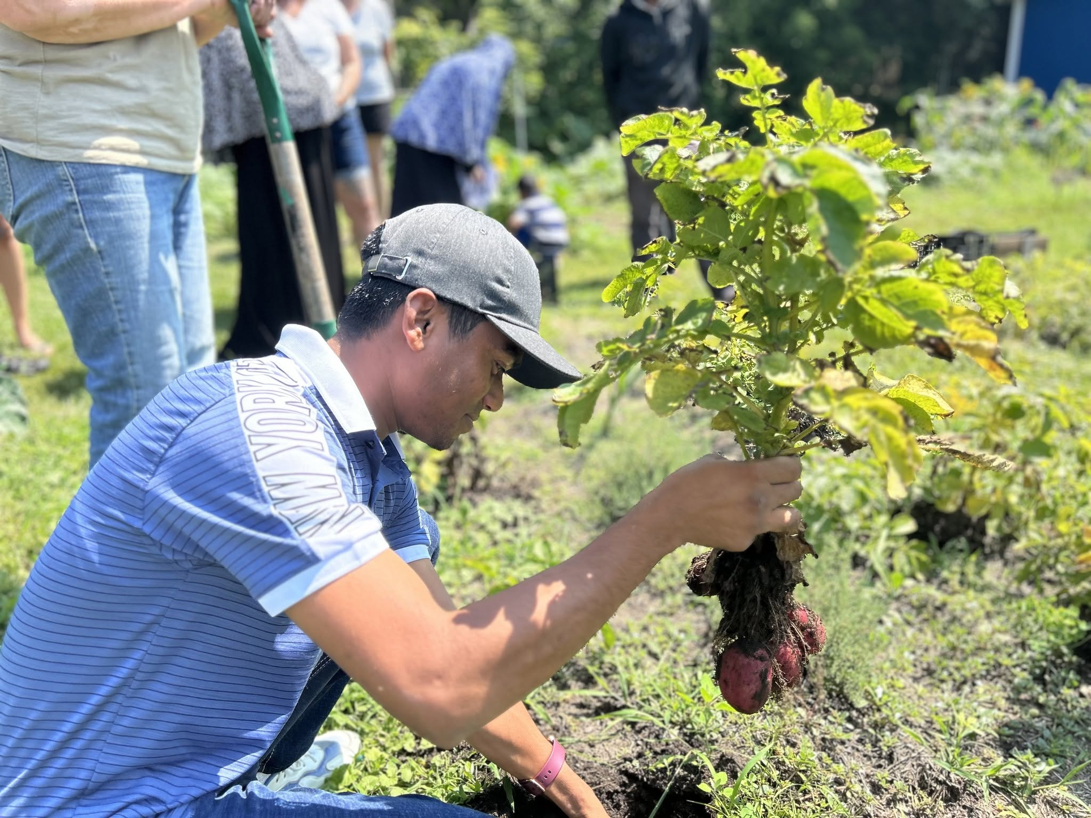
The Hunger Coalition
The United Way Hunger Coalition works to increase food access in our community by taking fresh, healthy food directly to families in need.
Farm to Family Produce Program
The Hunger Coalition purchases fresh produce from local farms in Athens and packs it into CSA-style boxes for distribution through our food access partners.
Our Garden
Our Garden is a community garden prepared and maintained by United Way staff and volunteers. It is open to the public and provides fresh produce at no cost to anyone in need.
Mobile Market
The Hunger Coalition hosts mobile markets throughout Marathon County, bringing farm-fresh produce directly to neighborhoods.
The Egg Program
Eggs are purchased year-round in bulk from Kwik Trip and Ninepatch Farm and distributed to local pantries, non-profits, and at mobile markets.
The Great Carrot Harvest
Individuals donate to United Way to plant a bed of carrots. The carrots are grown by a local farm partner, and once harvested, the Hunger Coalition distributes them to local food pantries and service organizations in Marathon County.
To learn more, please contact MaiGer Moua at mmoua@unitedwaymc.org

Slide 7
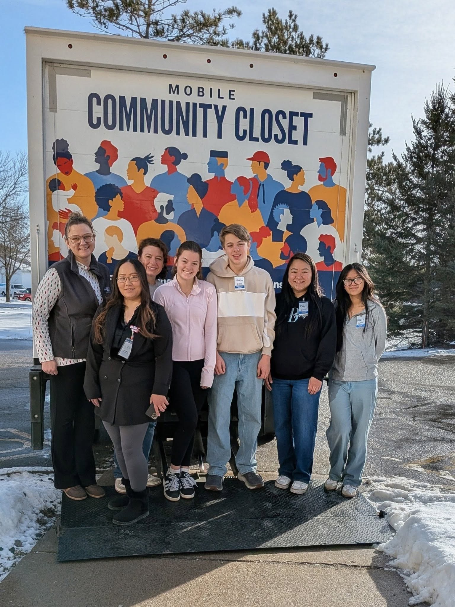
Community and Mobile Closet
The Community Closet gives new and gently used clothing to anyone who needs it. Each household member can get up to 10 clothing items and one pair of shoes once per month.
In 2025, United Way’s Community Closet provided free clothing to:
920 households through its primary location
291 households through its Mobile Closet program
59 community members received steel-toed boots to start or continue employment in manufacturing or construction roles as part of the Community Closet’s Boots to Work initiative.

Slide 8
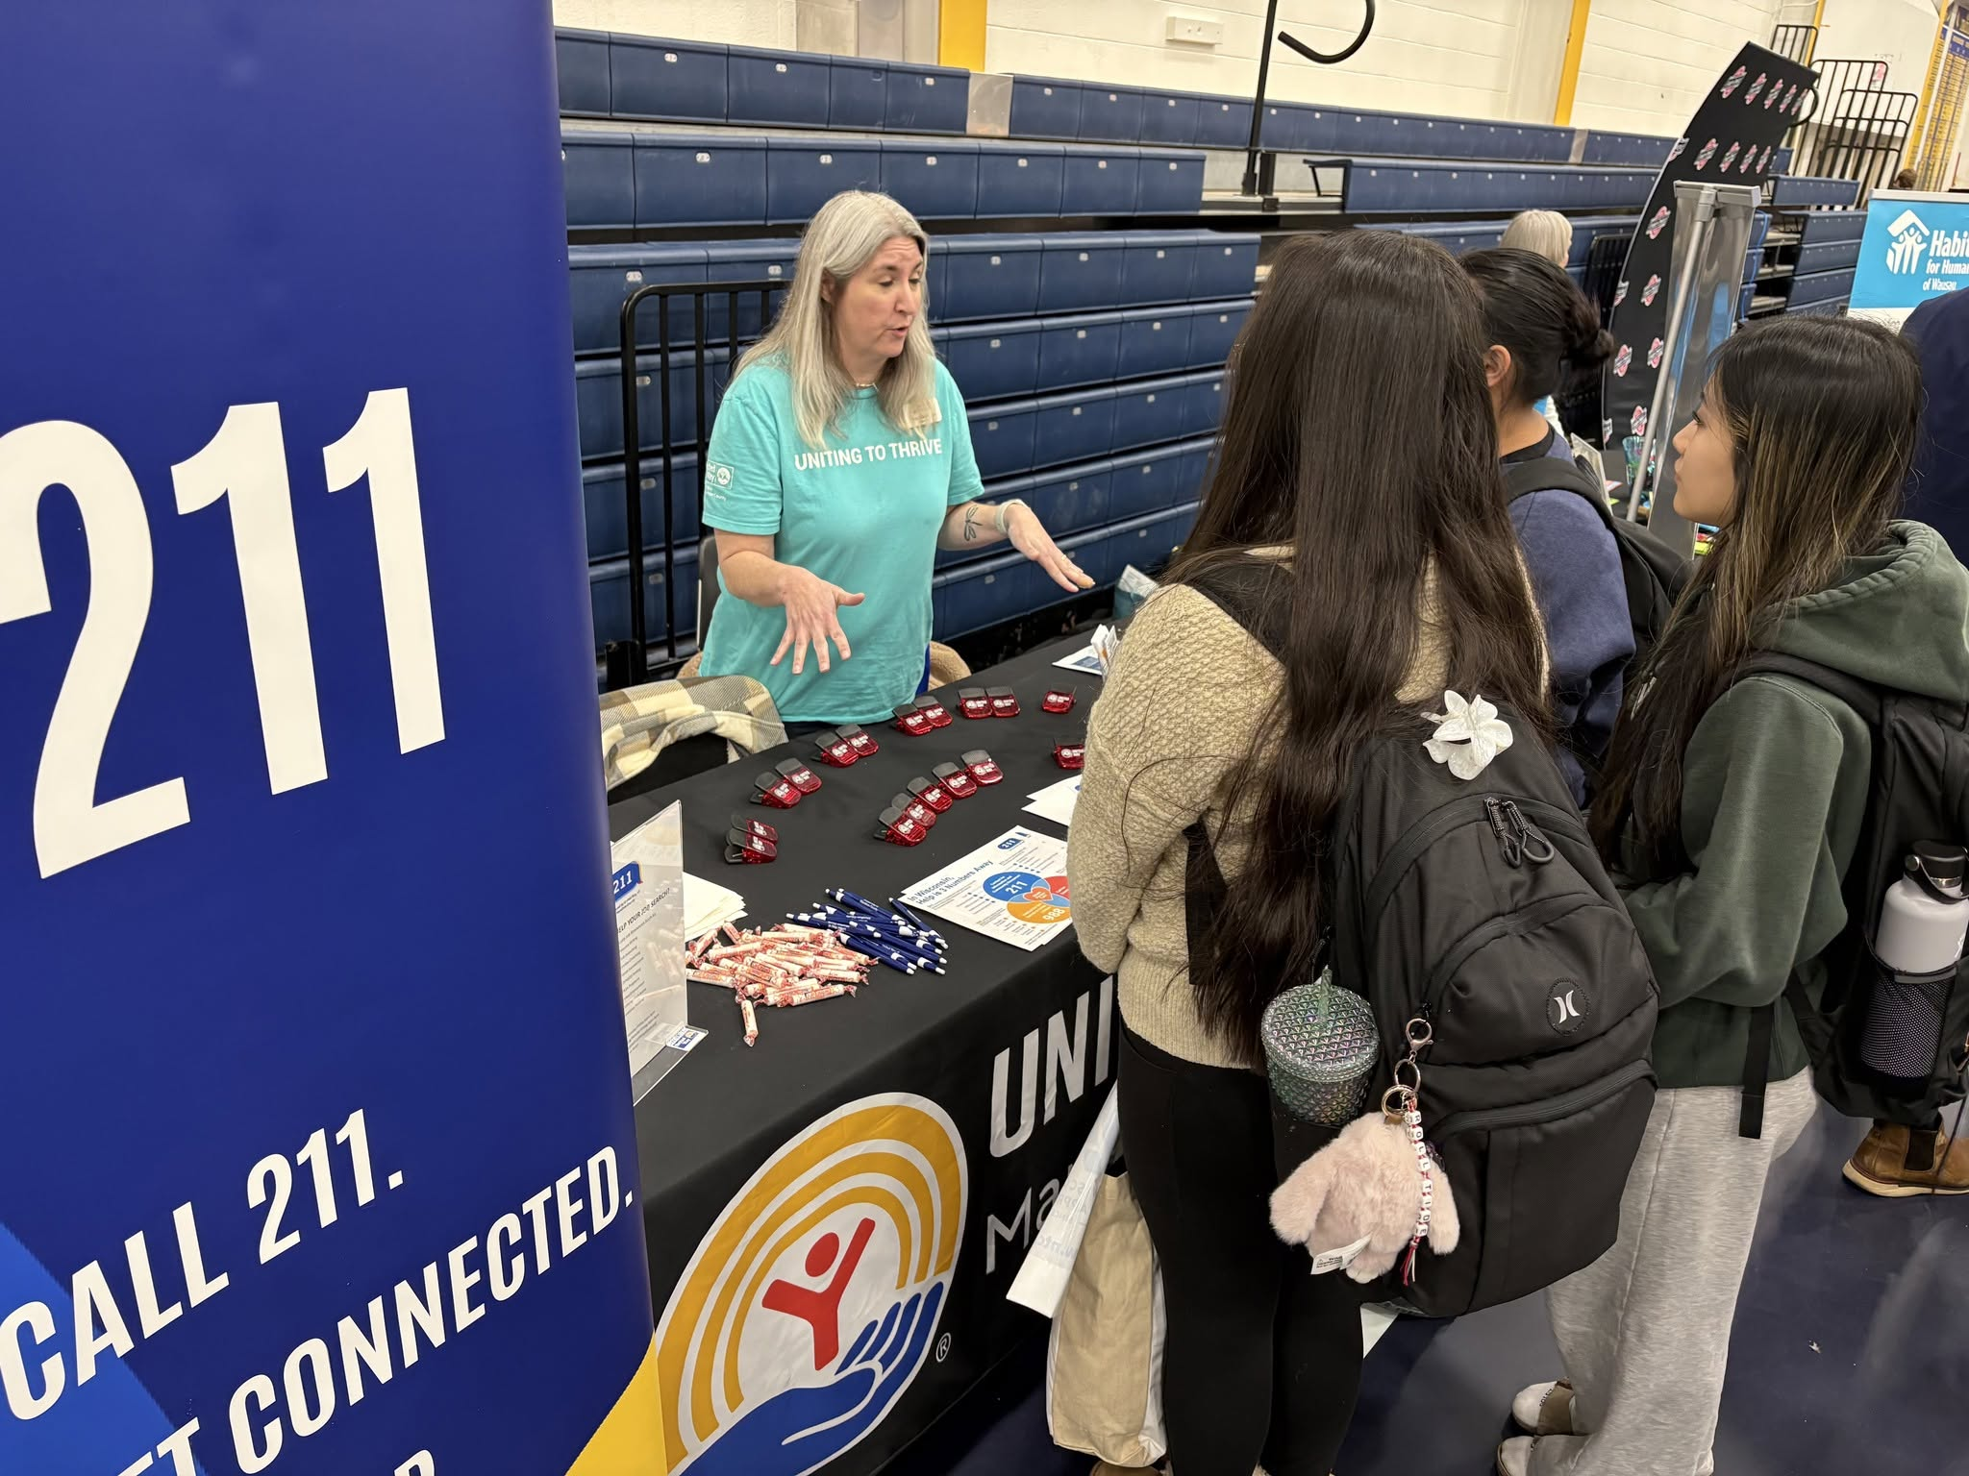
United Way’s 211 is a free, confidential information & referral service – available 24/7 for your health and human service needs. You are not alone; help is available.
In 2025, United Way’s 211 answered 4,614 requests for help from Marathon County residents, providing 11,063 referrals to community resources.

Slide 9
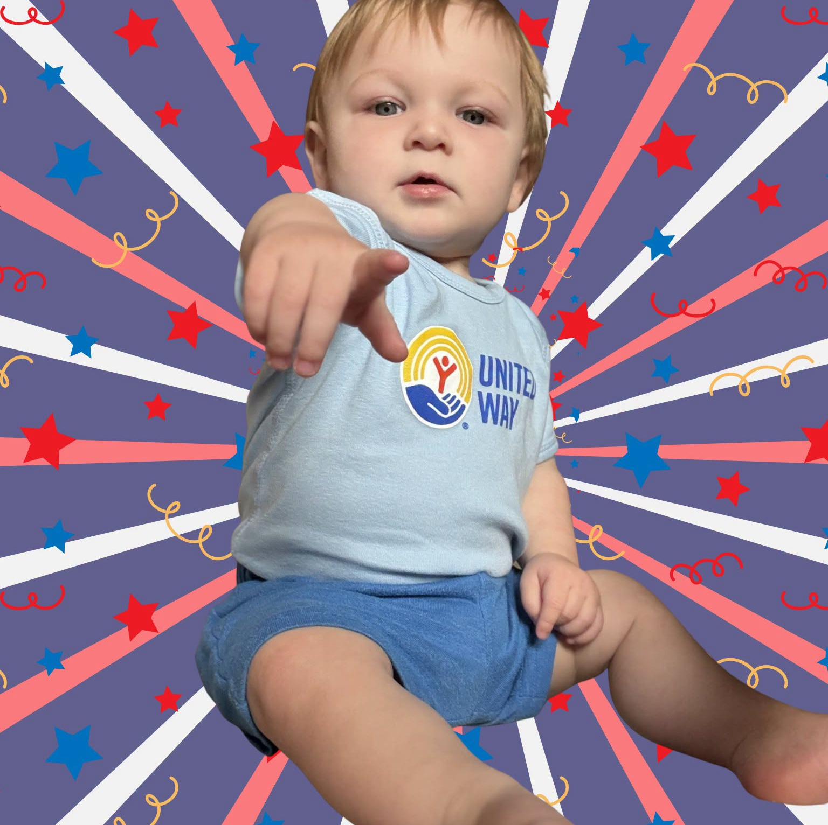
Progress Toward the Bold Goal
We can reach the BOLD Goal together!
33,239 Individuals Served
9,803 Community Members lifted to financial stability
11,474 Referrals made to other services, helping individuals continue their path to financial stability
www.unitedwaymc.org

Slide 10
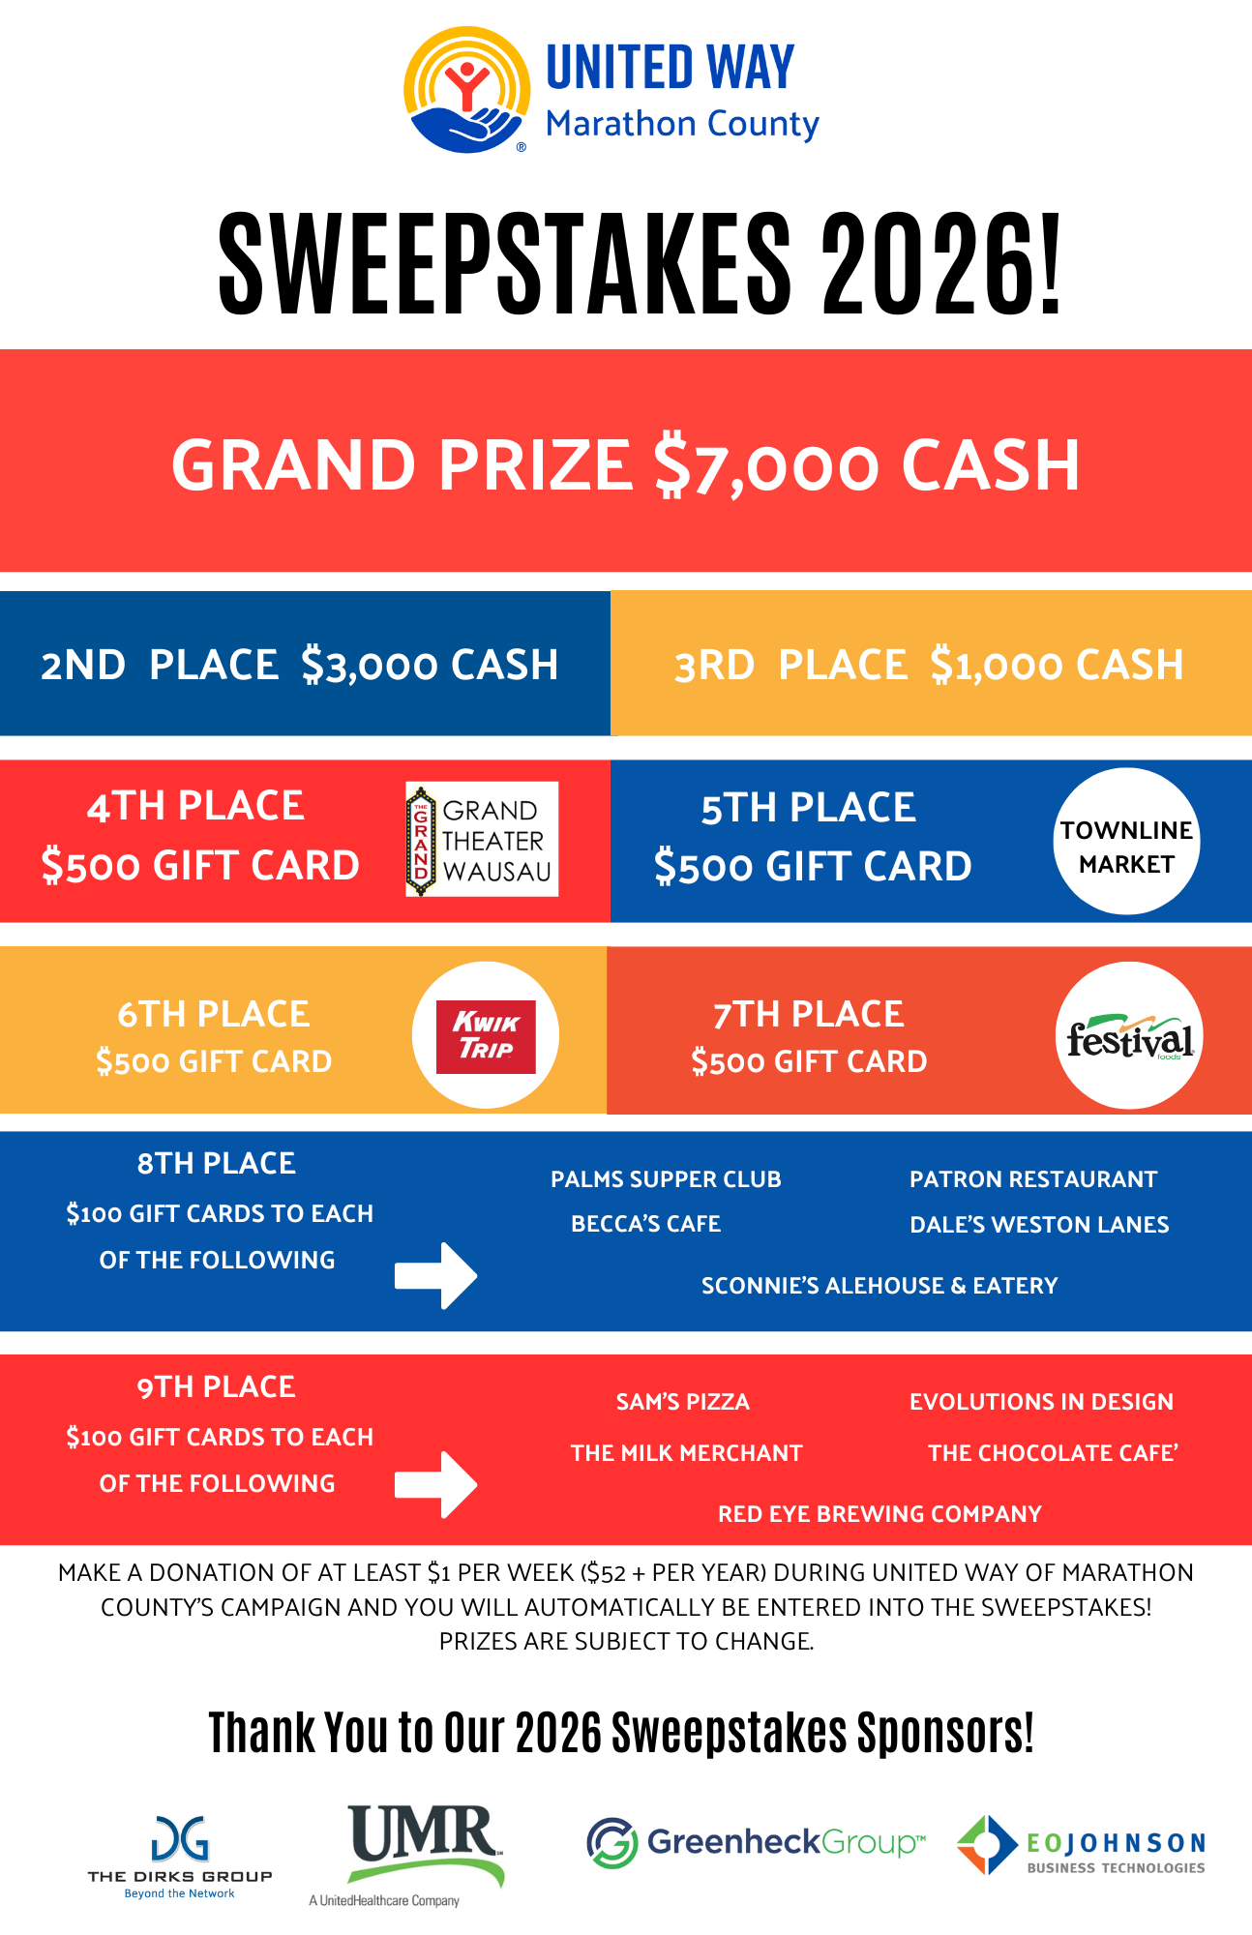
How can you help?
You can donate! There are many ways to give:
Payroll deduction through your employer
Credit card
Check or ACH
Donor-advised fund
Venmo
Paypal
Donate at least $52 to be entered into the sweepstakes. Donate more, and you receive more entries!

Slide 11
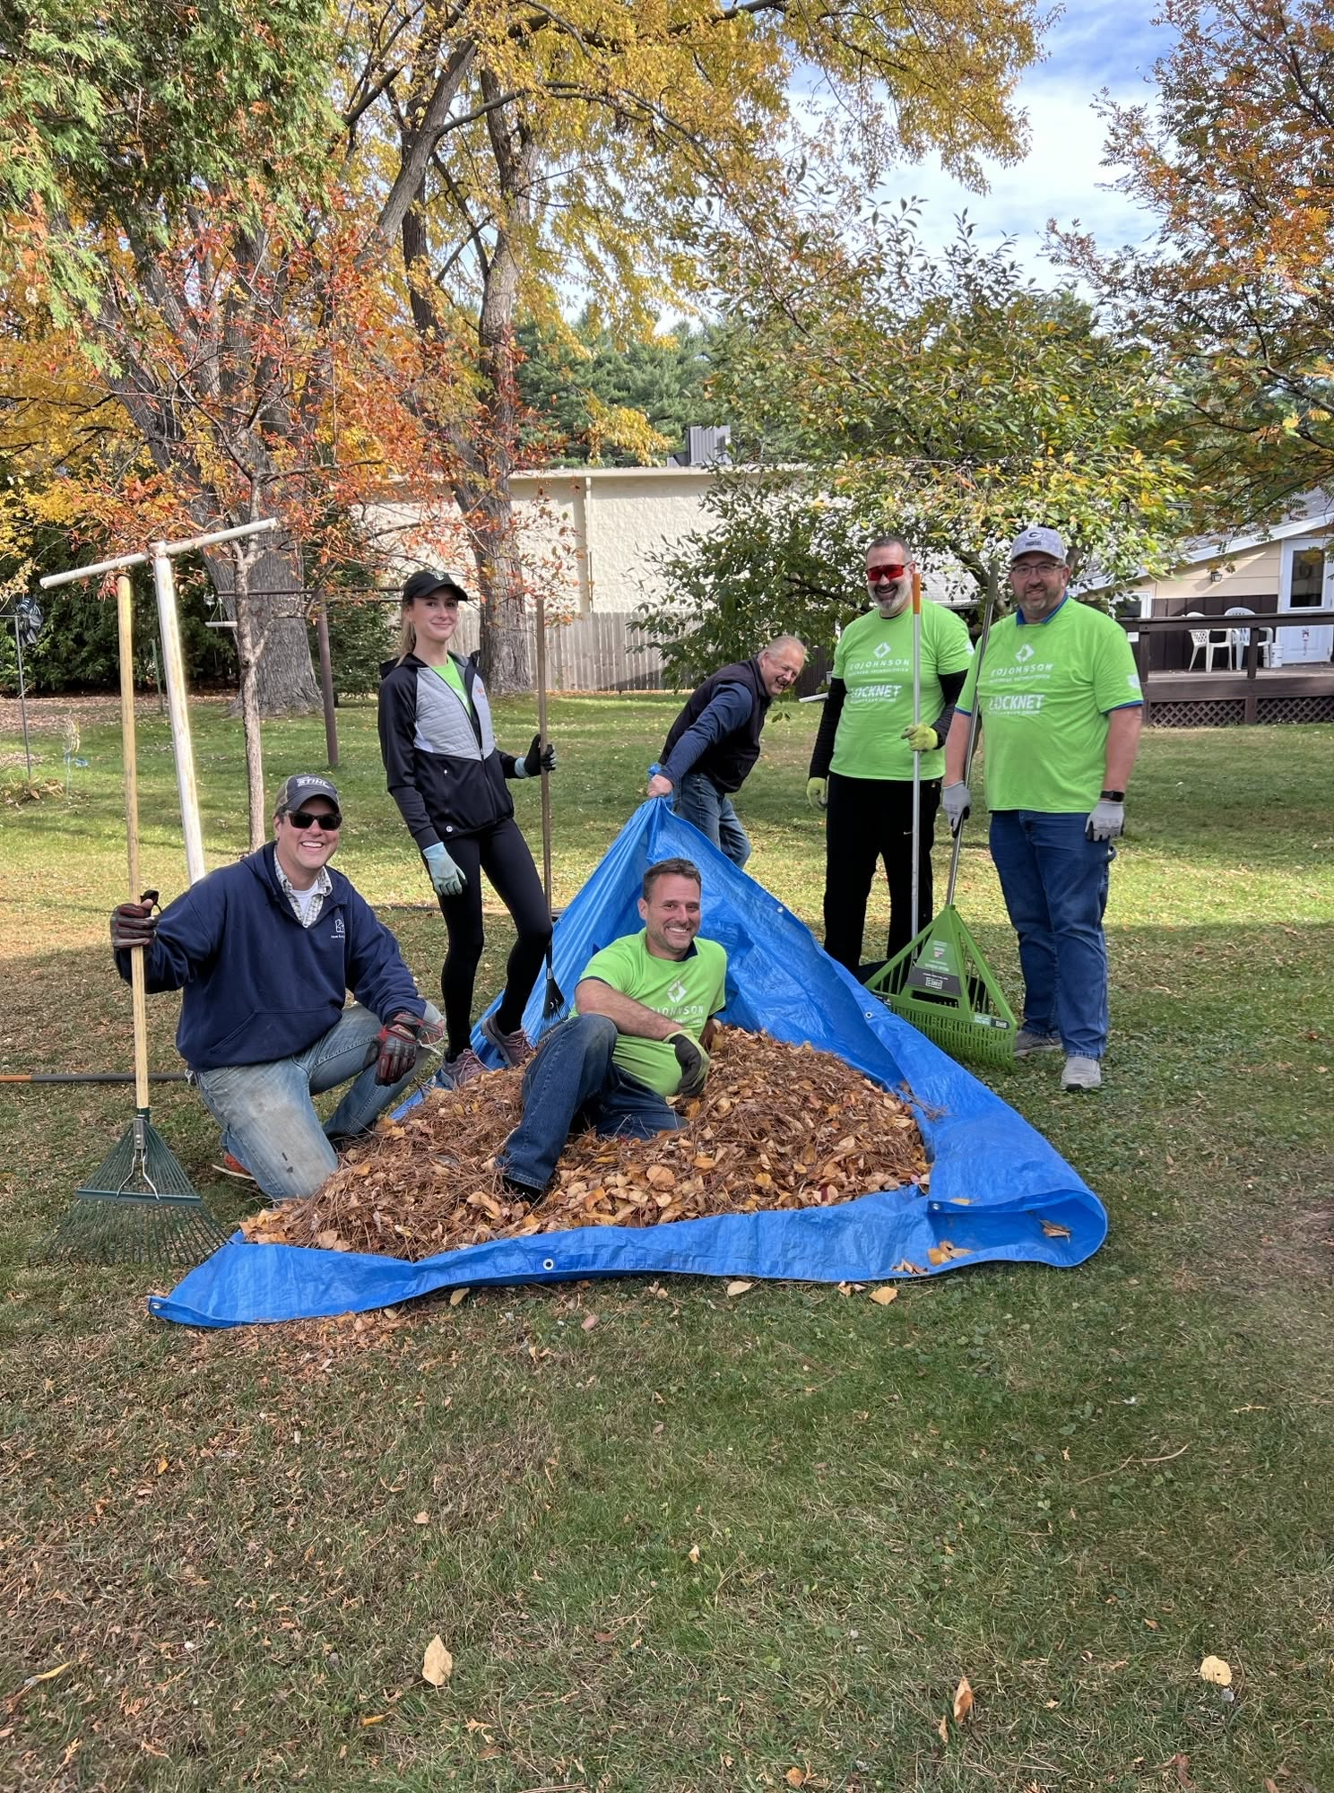
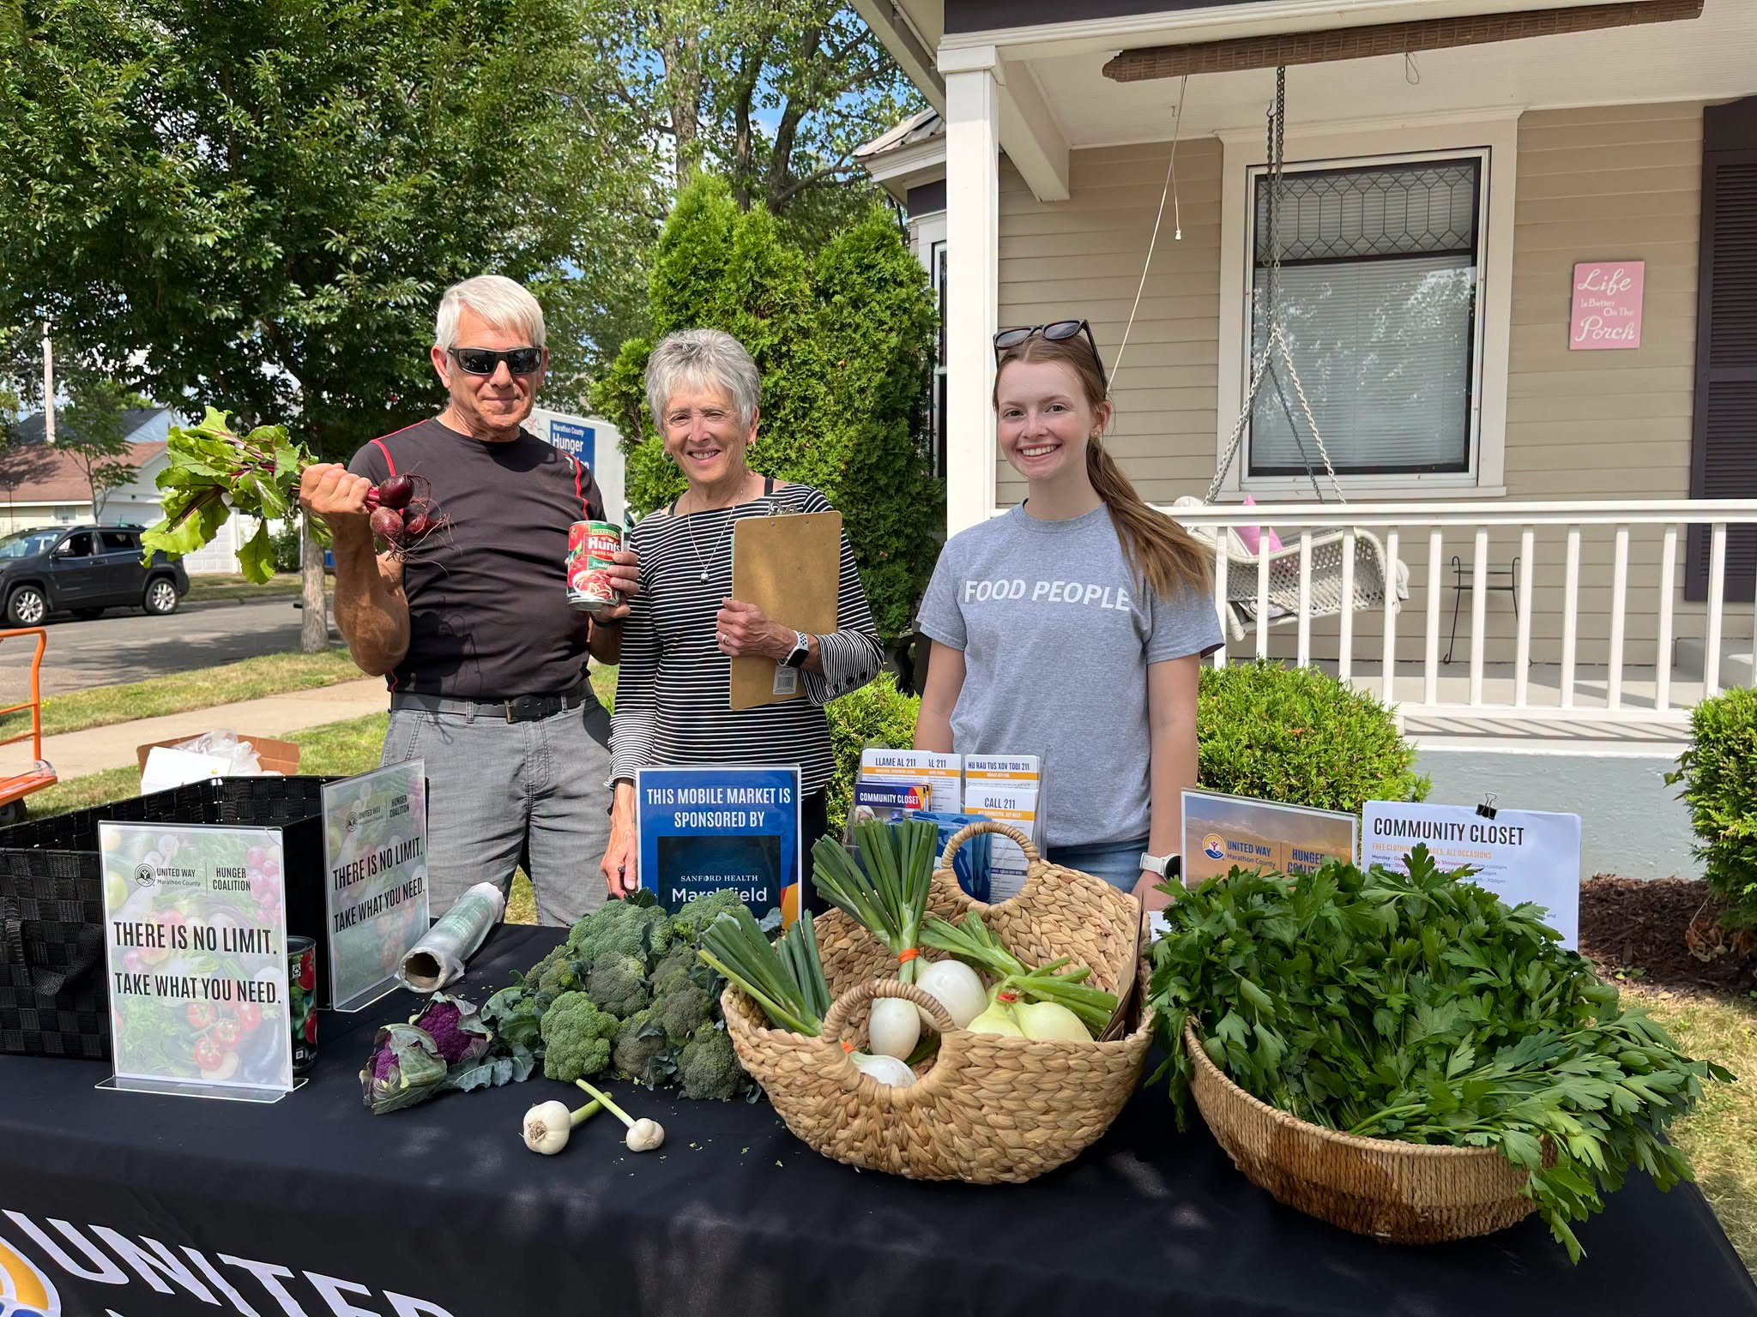
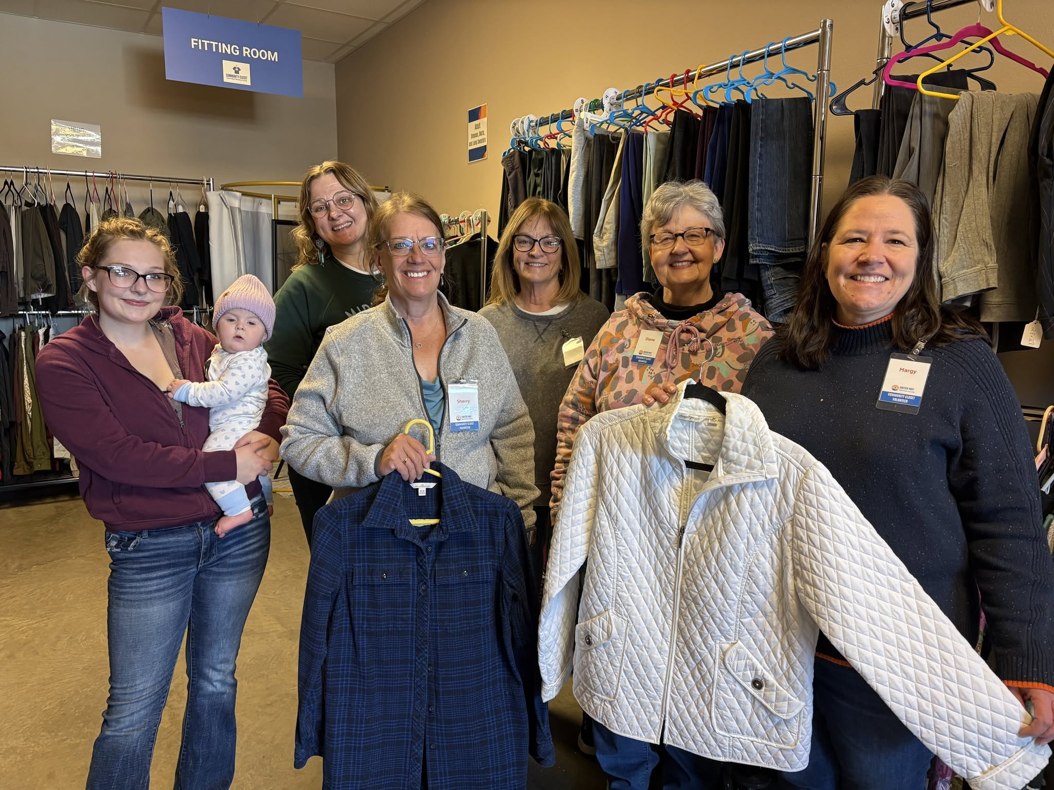
Volunteer https://www.unitedwaymc.org/volunteer

Slide 12

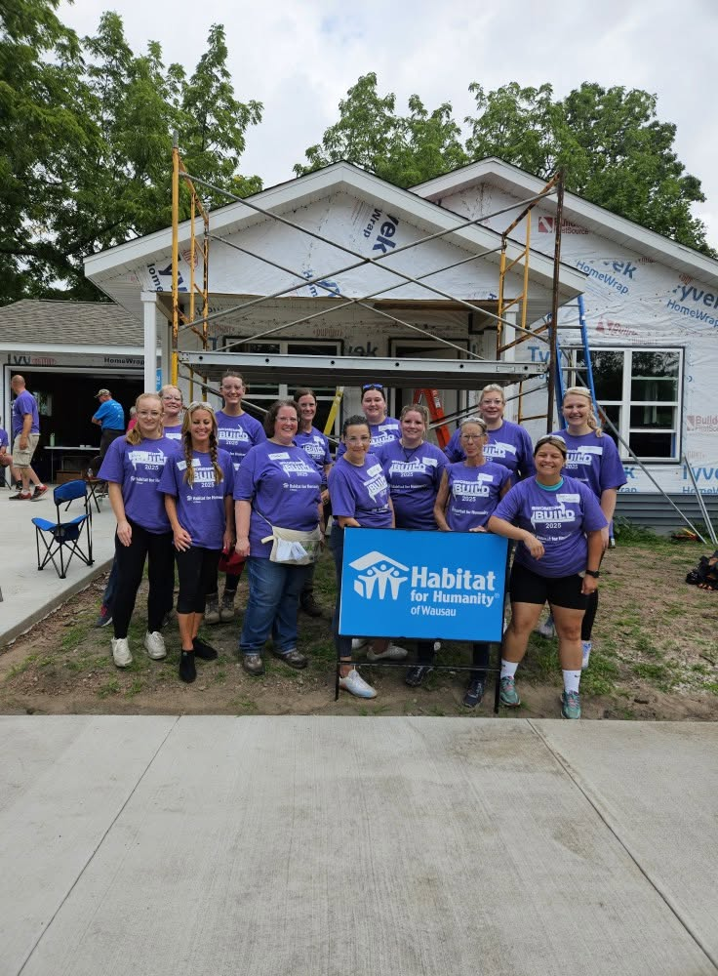
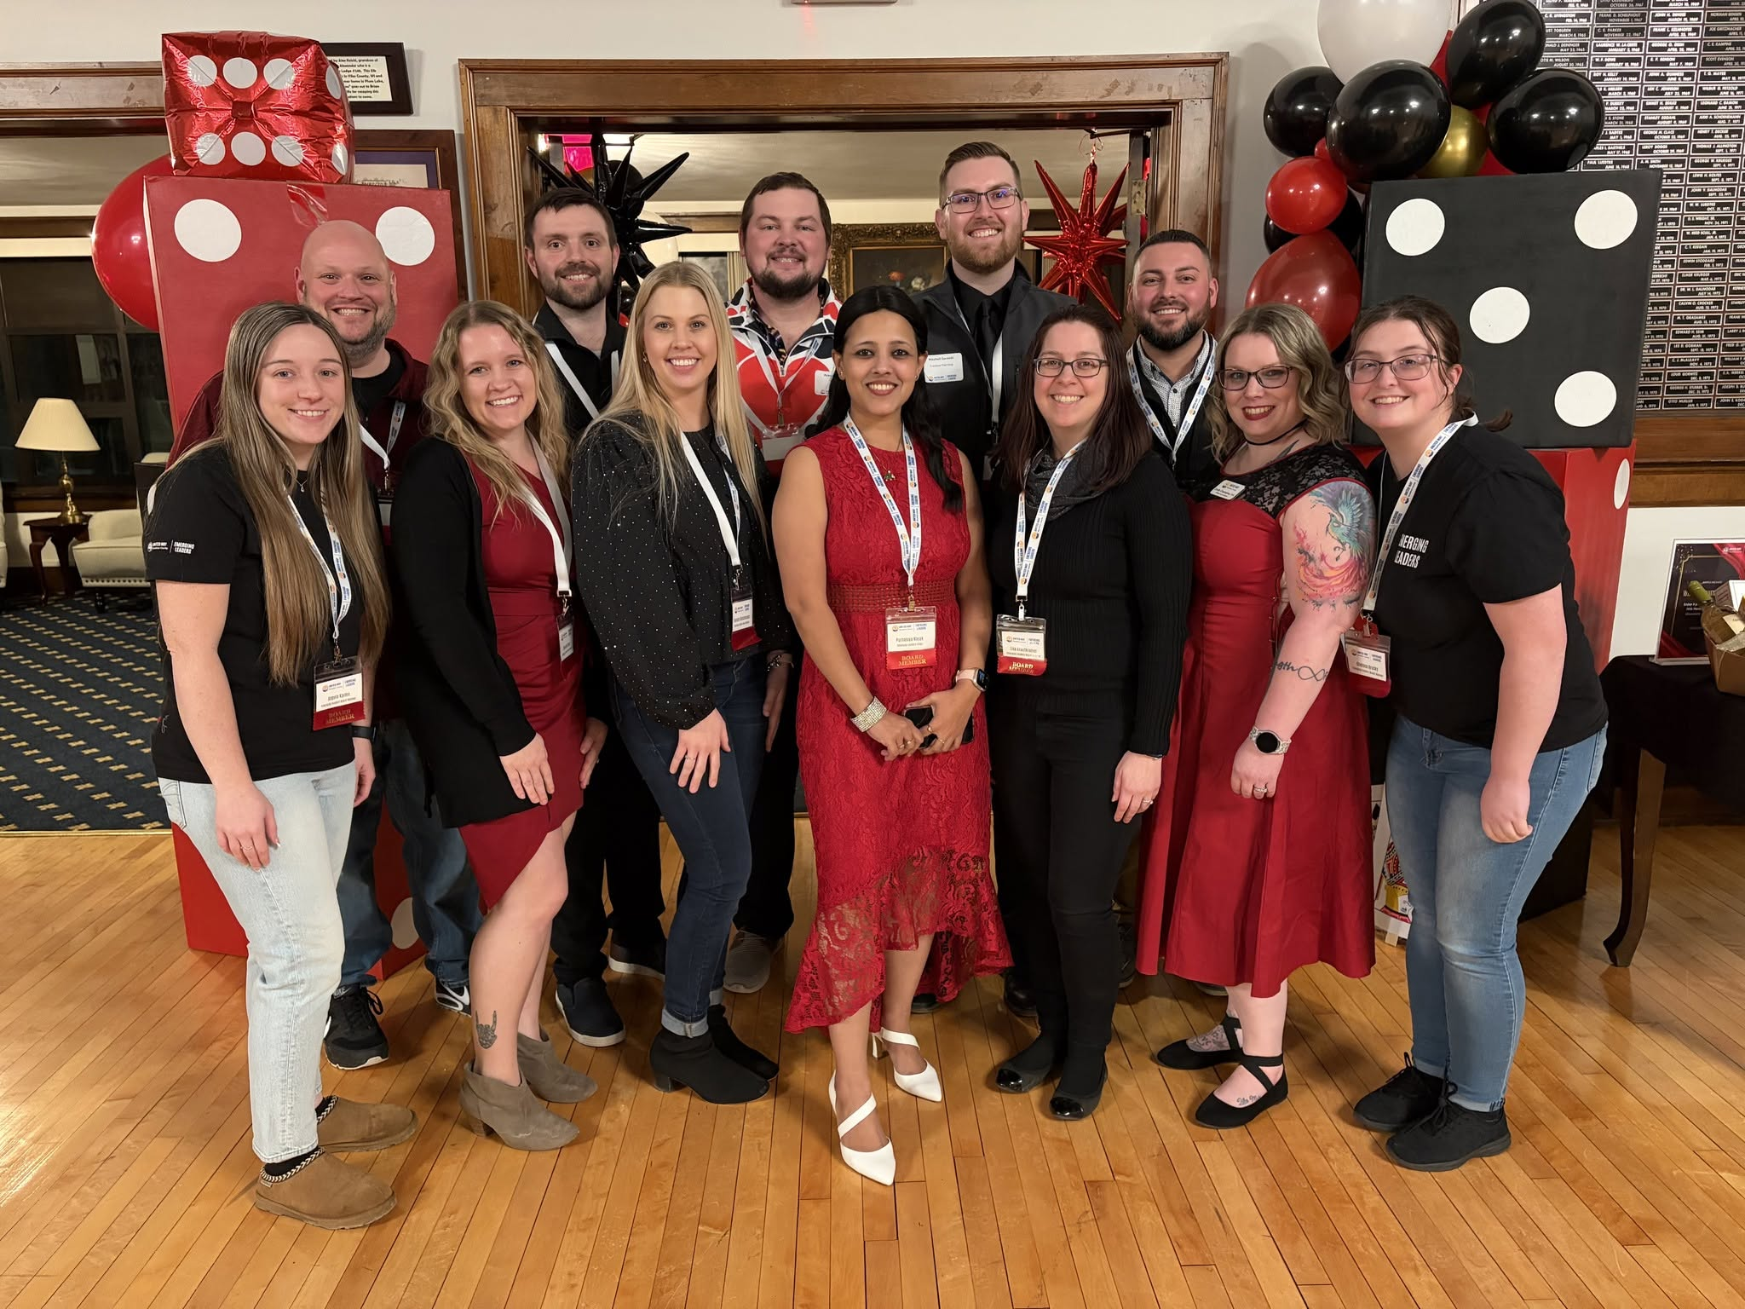
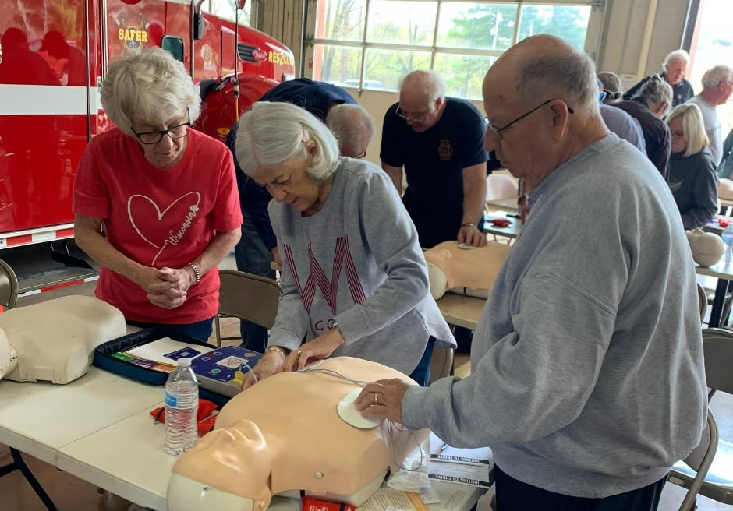
Join an Affinity Group! Network with a purpose
https://www.unitedwaymc.org/affinity-groups
Women United
Emerging Leaders
Retire United

Slide 13

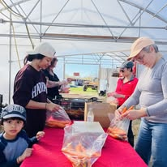
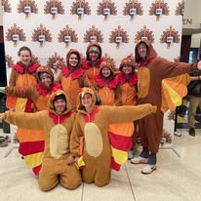
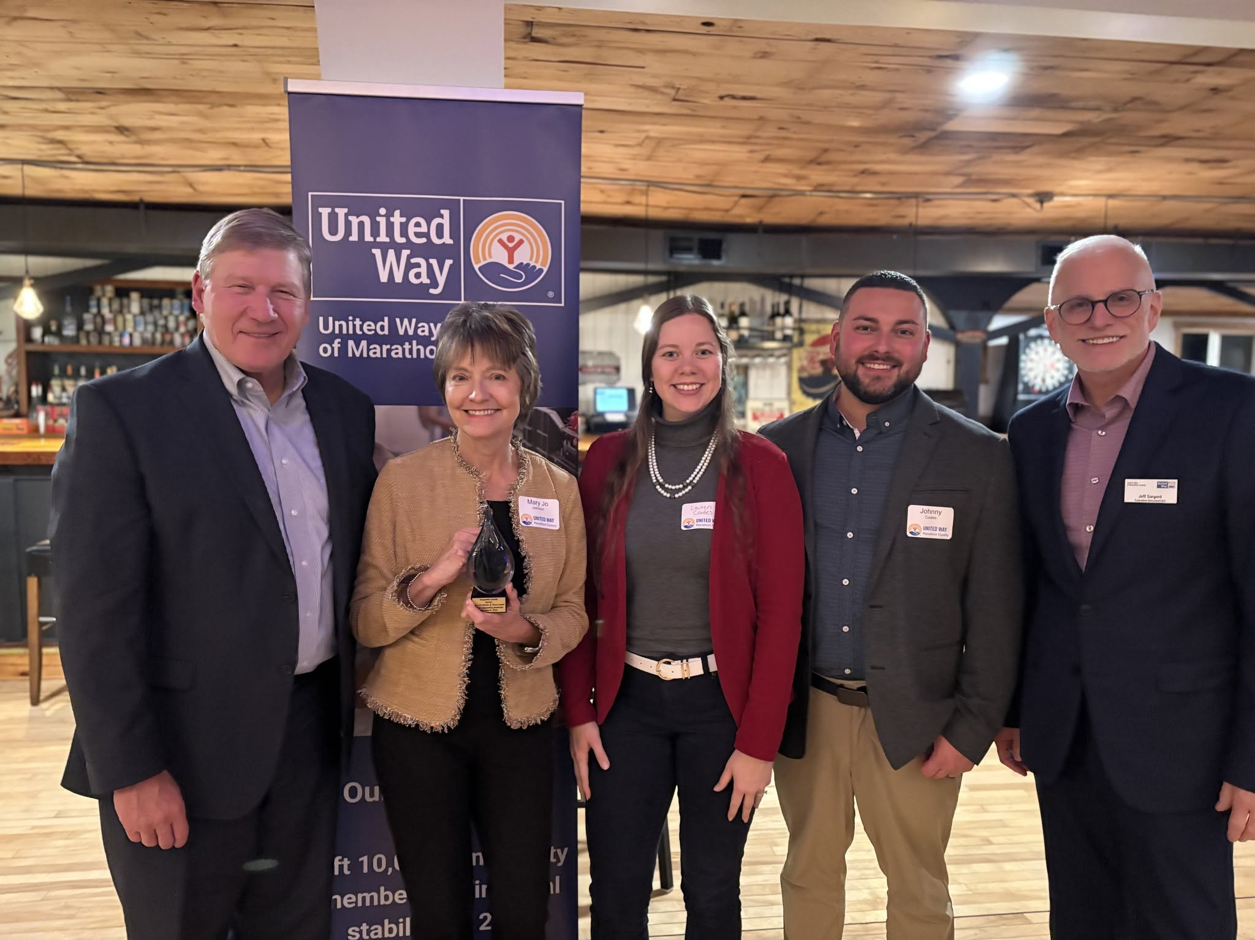
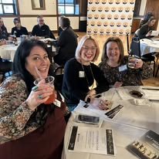
Attend an Event
https://www.unitedwaymc.org/events

Slide 14

Thank you for supporting your local community!
Questions?
Contact Amanda Flannery, aflannery@unitedwaymc.org
Visit: https://www.unitedwaymc.org/
Subscribe to our newsletter: https://www.unitedwaymc.org/contact-us

